Slide 1
Unsupervised Learning 1: Improving the K-Means Algorithm
Juri Kembügler
25.01.2025

Slide 2
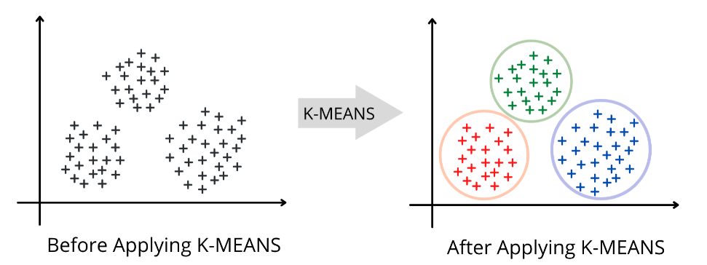
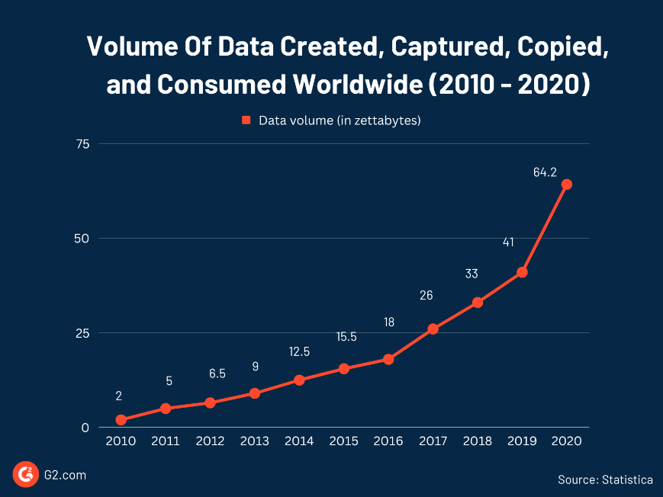
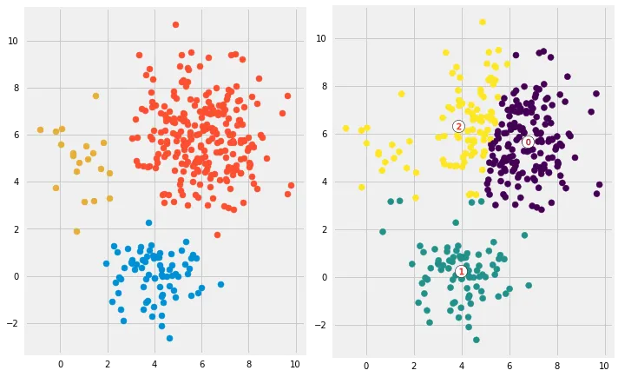
Motivation
Fig. 2: Data before and after clustering [18].
Fig. 1: Volume of data worldwide [20].
Fig. 3: Good and bad clustering [19].

Slide 3
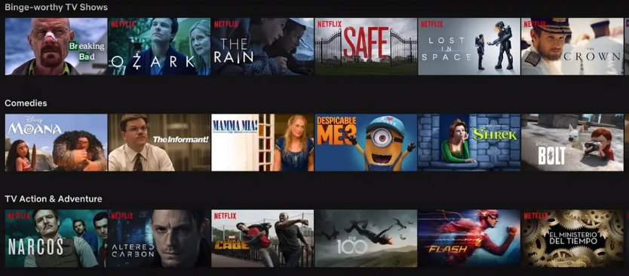
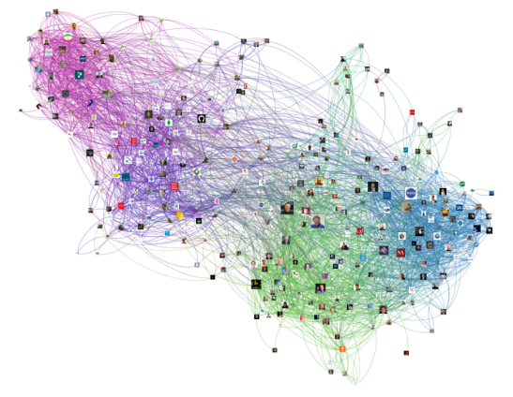
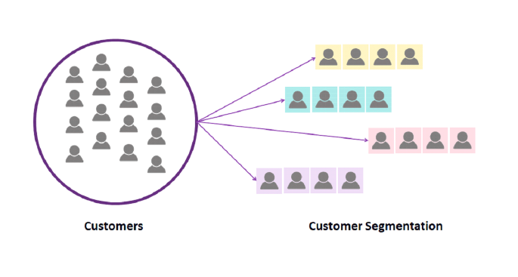
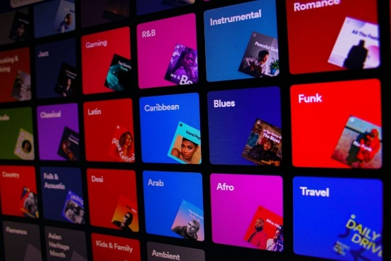
Applications [9]
Collaborative Filtering
Social Network Analysis
Fig. 4: Netflix recommendations [14].
Fig. 5: Twitter network visualisation [15].
Customer Segmentation
Multimedia Data Analysis
Fig. 6: Customer Segmentation [16].
Fig. 7: Spotify genres [16].

Slide 4
Outline
Introduction
Types of Clusters
Background
Challenges of K-Means
Potential Improvements
Results
Demo: Improved Algorithm ‒ Mall Customer Segmentation
Summary
References

Slide 5
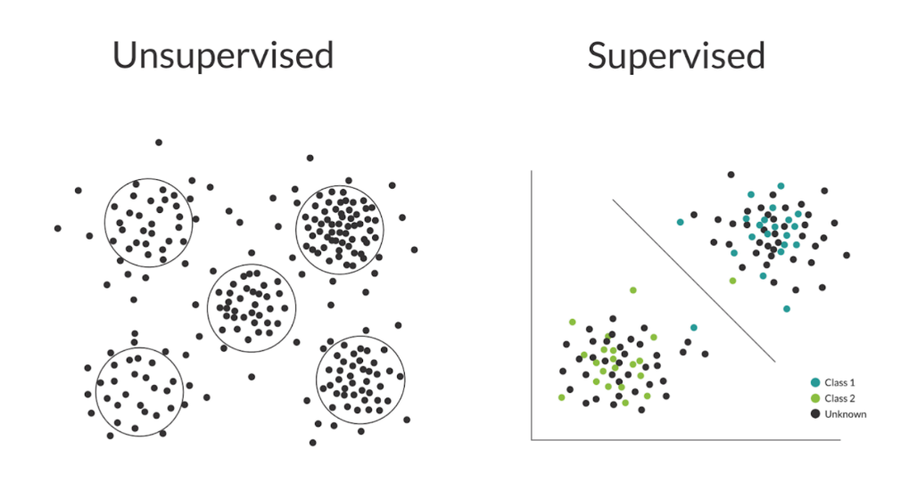
Introduction: Unsupervised Learning
Two major classes of Machine Learning (ML) techniques [1]
Supervised ML technique
Observes a dataset of both input and output ahead of time
Tries to predict unseen output on a new given input
Fig. 8: Unsupervised vs. Supervised [10].

Slide 6
Introduction: Unsupervised Learning
Two major classes of Machine Learning (ML) techniques [1]
Unsupervised ML technique
Observes a dataset of only the input
Tries to summarize or describe the data
Fig. 8: Unsupervised vs. Supervised [10].

Slide 7
Introduction: Unsupervised Learning
Unsupervised ML techniques: [2]
Clustering
Association Rule Learning
Dimension Reduction
Anomaly Detection
Fig. 8: Unsupervised vs. Supervised [10].

Slide 8
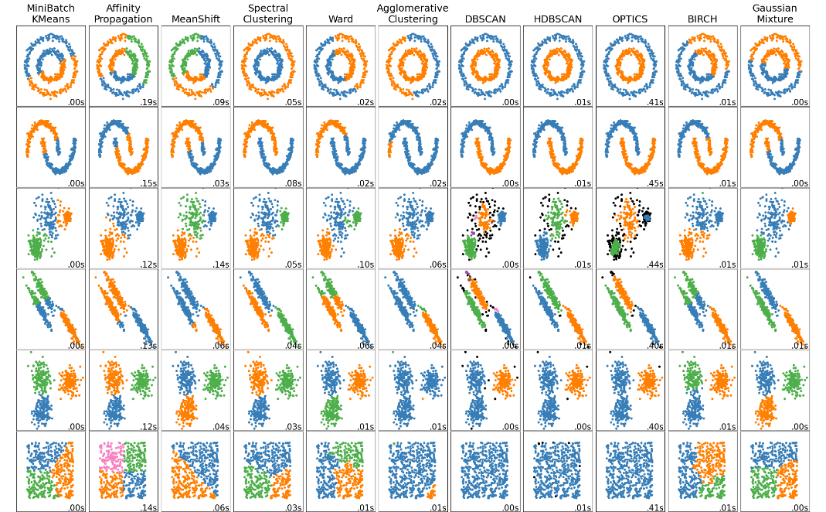
Introduction: Clustering
What is Clustering? [1]
Group data points that are ‘similar’
The idea of data being ‘similar’ implies some sort of distance measurement
Fig. 9: Various clustering algorithms [11].

Slide 9
Introduction: Clustering
Why do we need clustering? [1]
Simplifies data by categorizing it for easier human interpretation
Serves as a preprocessing step for other methods (e.g., feature creation for supervised learning)
Highlights characteristics that distinguish data points
Determines the number of distinct groups in the data
Fig. 9: Various clustering algorithms [11].

Slide 10
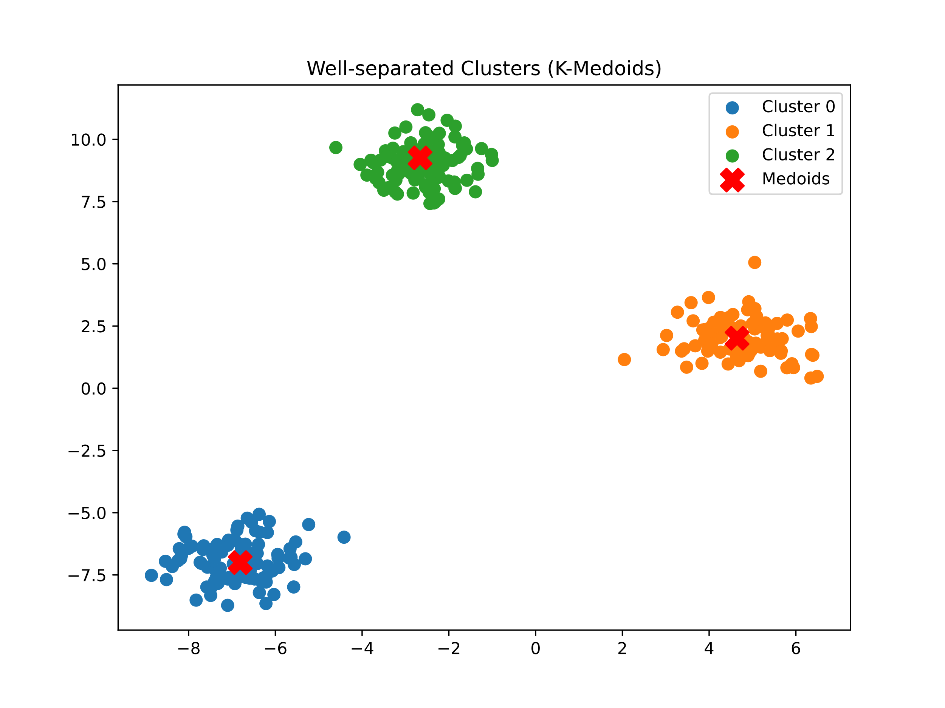
Types of Clusters: Well-separated clusters
„A point in a cluster is closer or more similar to any point in the same cluster than to a point in another cluster.” [5]
Suitable algorithms
Hierarchical clustering (complete linkage, single linkage)
Spectral Clustering
K-Medoids
Gaussian Mixture Models
Fig. 10: Well-separated clusters [6].

Slide 11
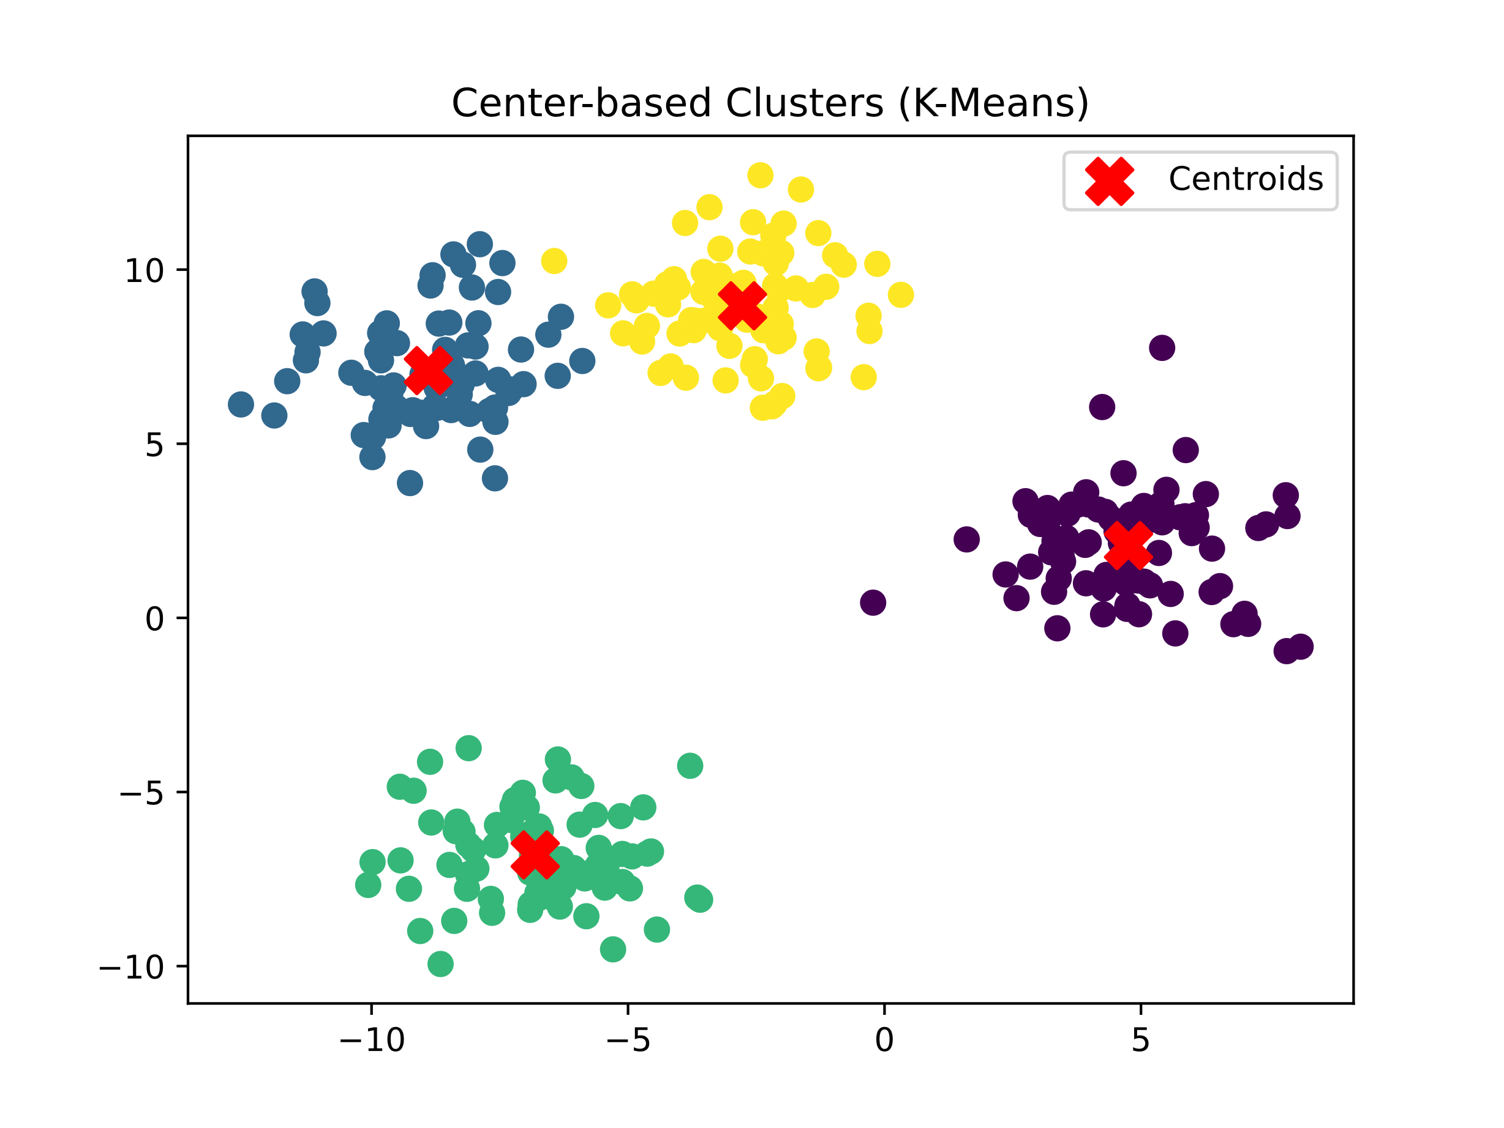
Types of Clusters: Centre-based clusters
„A point in a cluster is closer or more similar to the ‘centre’ of this cluster than to the centre of another cluster.” [5]
Suitable algorithms
K-Means
K-Medoids
Fuzzy c-means
Fig. 11: Centre-based clusters [6].

Slide 12
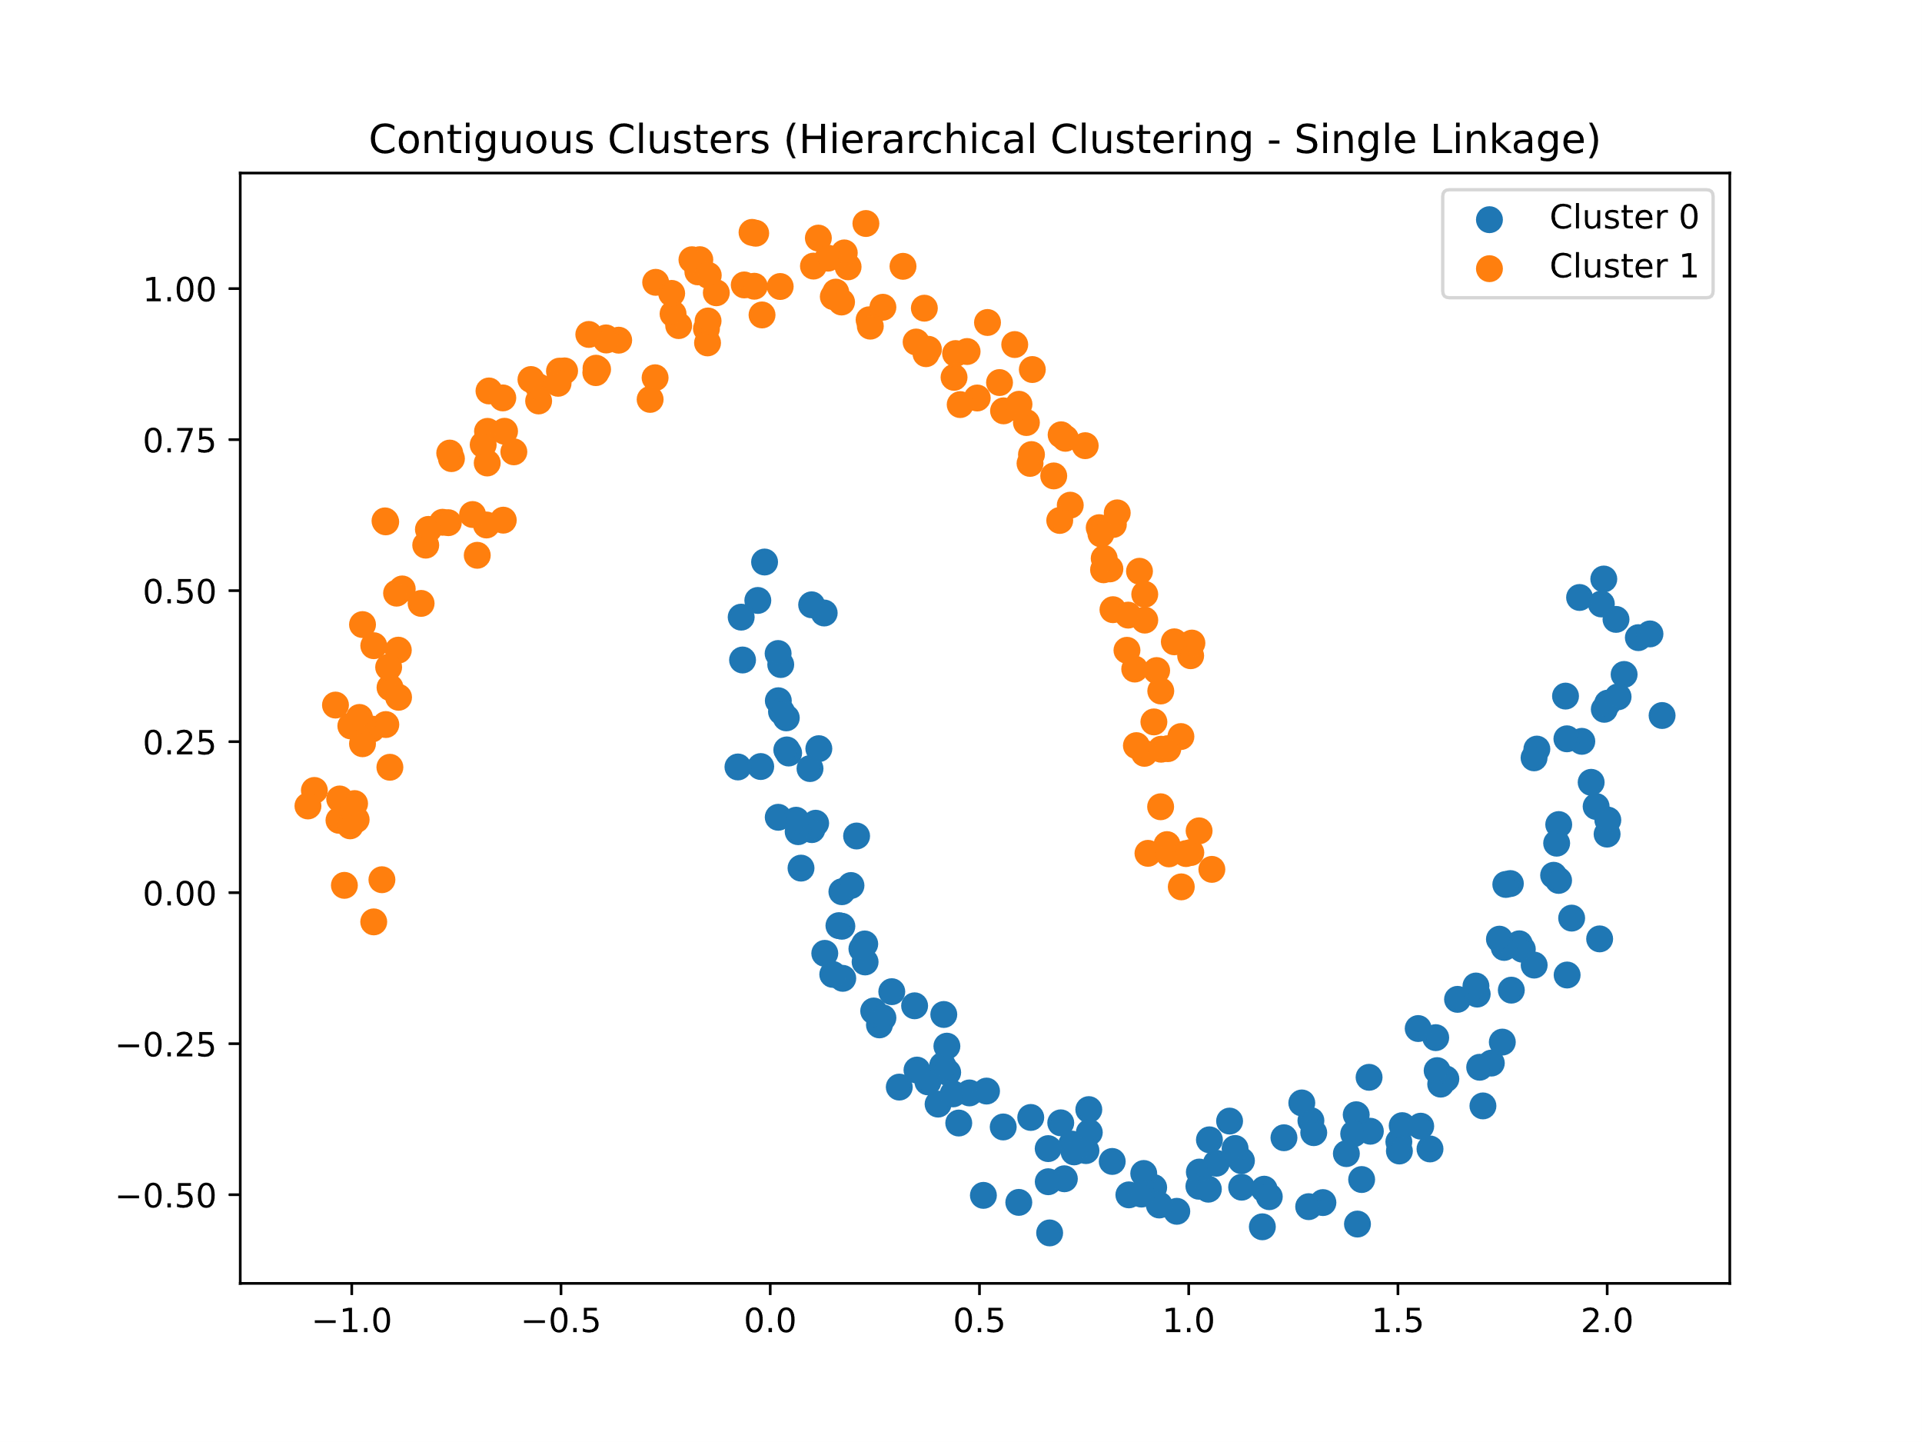
Types of Clusters: Contiguous clusters
„A point in a cluster closer to one or more points in the same cluster than to any other point not in the cluster.” [5]
Suitable algorithms
Hierarchical Clustering (Single-Linkage)
DBSCAN
Fig. 12: Contiguous clusters [6].

Slide 13
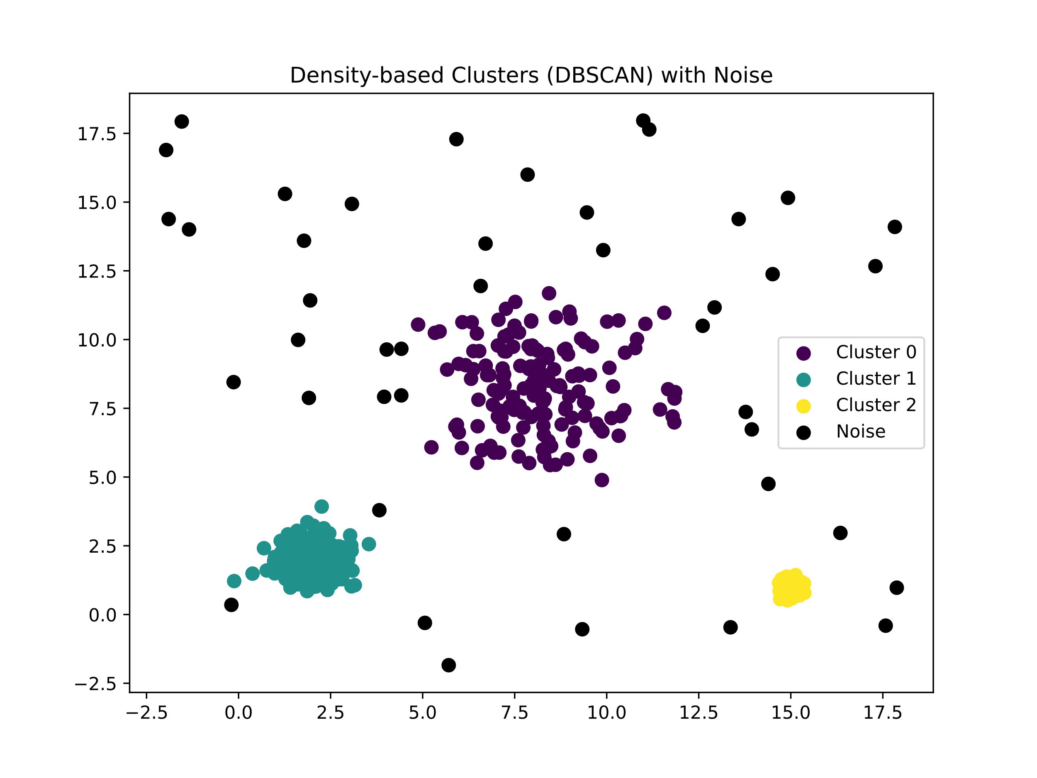
Types of Clusters: Density-based clusters
„A cluster is a dense region of points separated from the other high-density regions by low-density regions.” [5]
It is used when the clusters are very irregular and when noise and outliers are present [5]
Suitable algorithm
DBSCAN
Fig. 13: Density-based clusters [6].

Slide 14
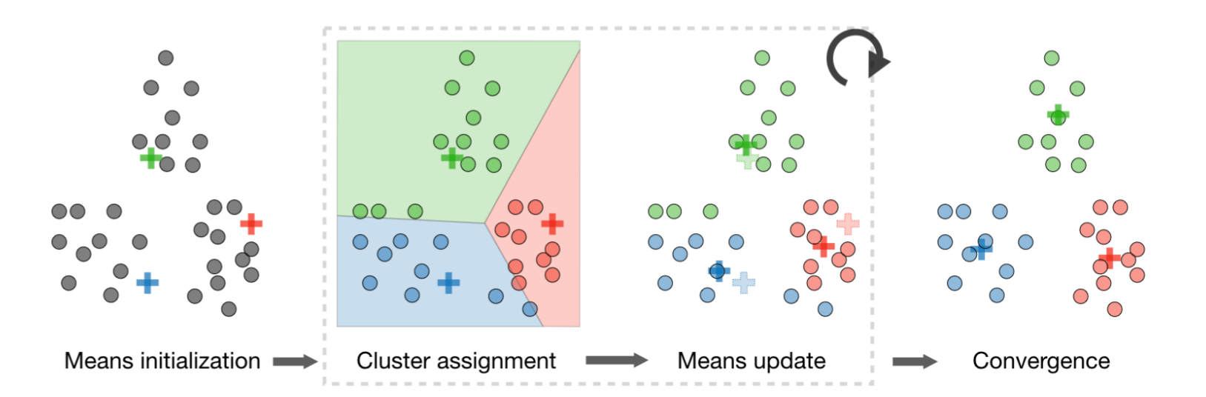
Background: K-Means
Procedure:
Randomly initialize centroids
Assign data points to the nearest cluster
Update centroids based on assignments
Repeat 2 and 3 until convergence
Fig. 14: K-Means visualisation [3].

Slide 15
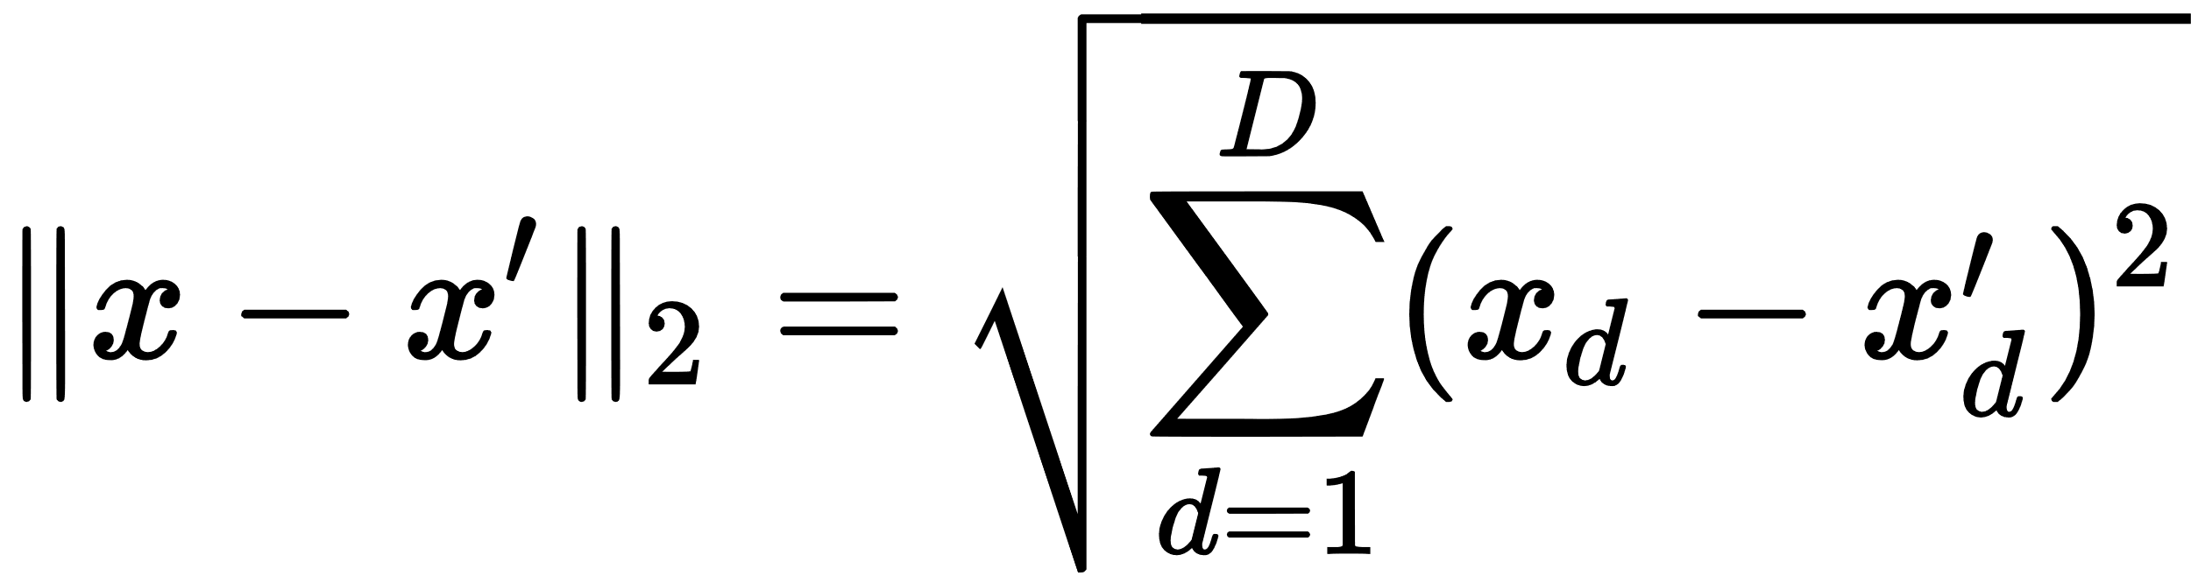
Background: K-Means
What does ‘similar’ mean?
‘Similar’ requires a distance measure, e.g., 2-norm or Euclidean distance
Distance quantifies how different two points are
Using Euclidean distance defines Lloyd’s algorithm

Slide 16
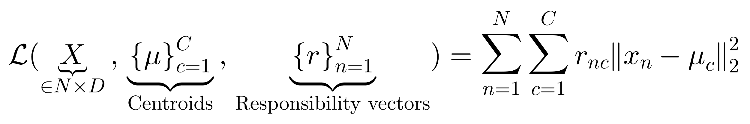
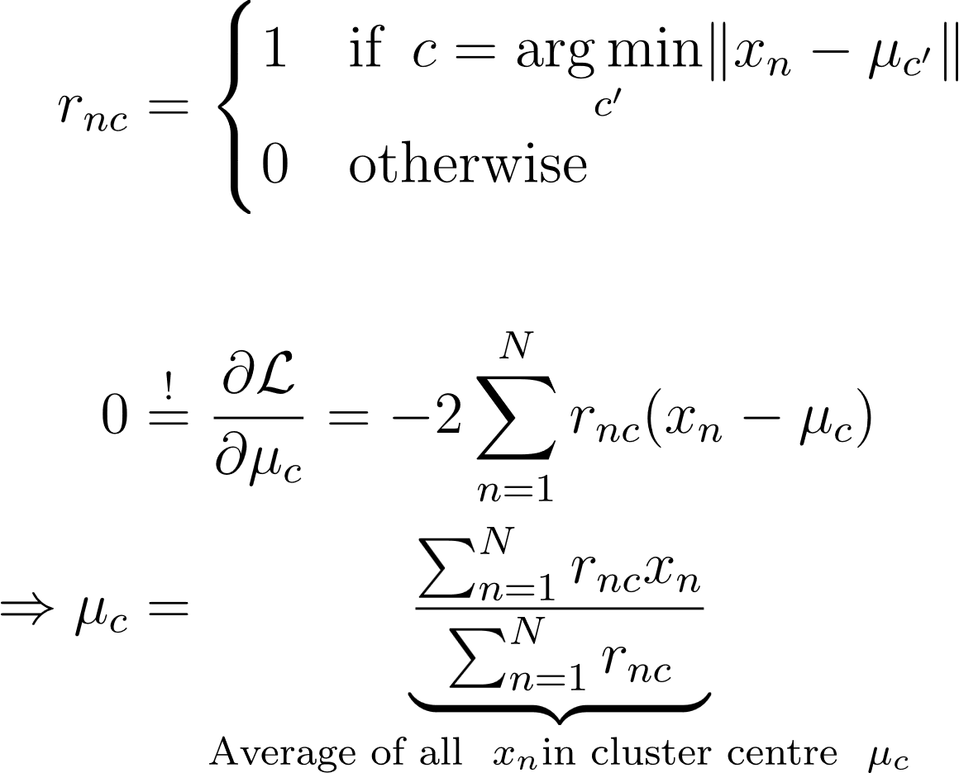
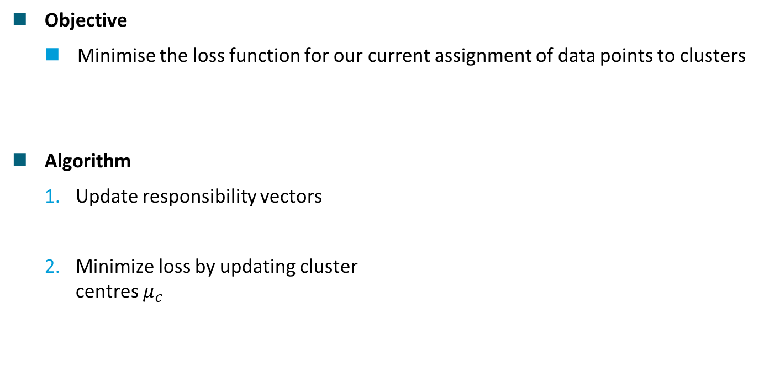
Background: Lloyd's algorithm [1]
Objective
Minimise the loss function for our current assignment of data points to clusters
Algorithm
Update responsibility vectors
Minimize loss by updating cluster centres $μ_{c}$

Slide 17
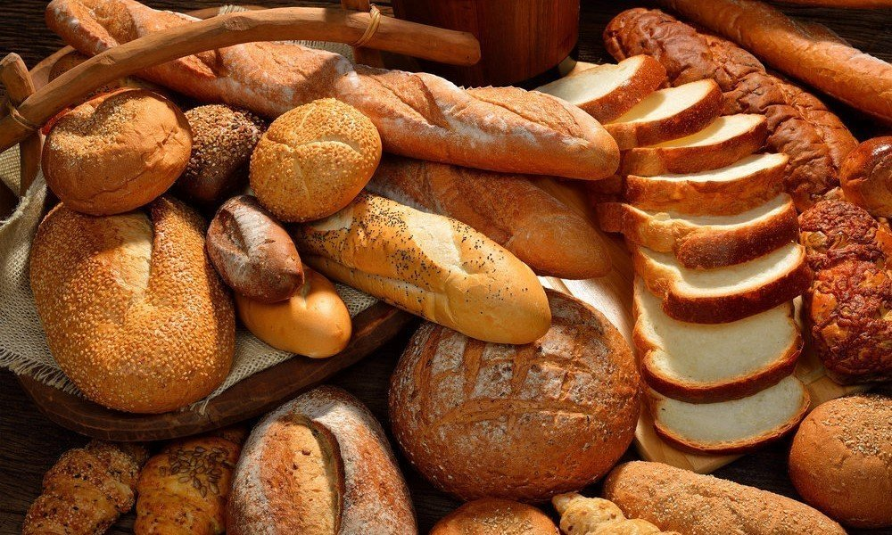
Background: Example
Scenario
Organizing a ML seminar
We buy assorted baked goods
Due to time constraints, all items are in one basket
Objective
Cluster and organize the goods by shape, size or type
Fig. 15: Different types of bread [4].

Slide 18
Background: Example
Setting up a similarity metric
Characteristics of a baked good
height, width, depth, colour, density, etc.
To keep it simple we use two dimensions
the area occupied by a baked product
how brown a baked good is

Slide 19
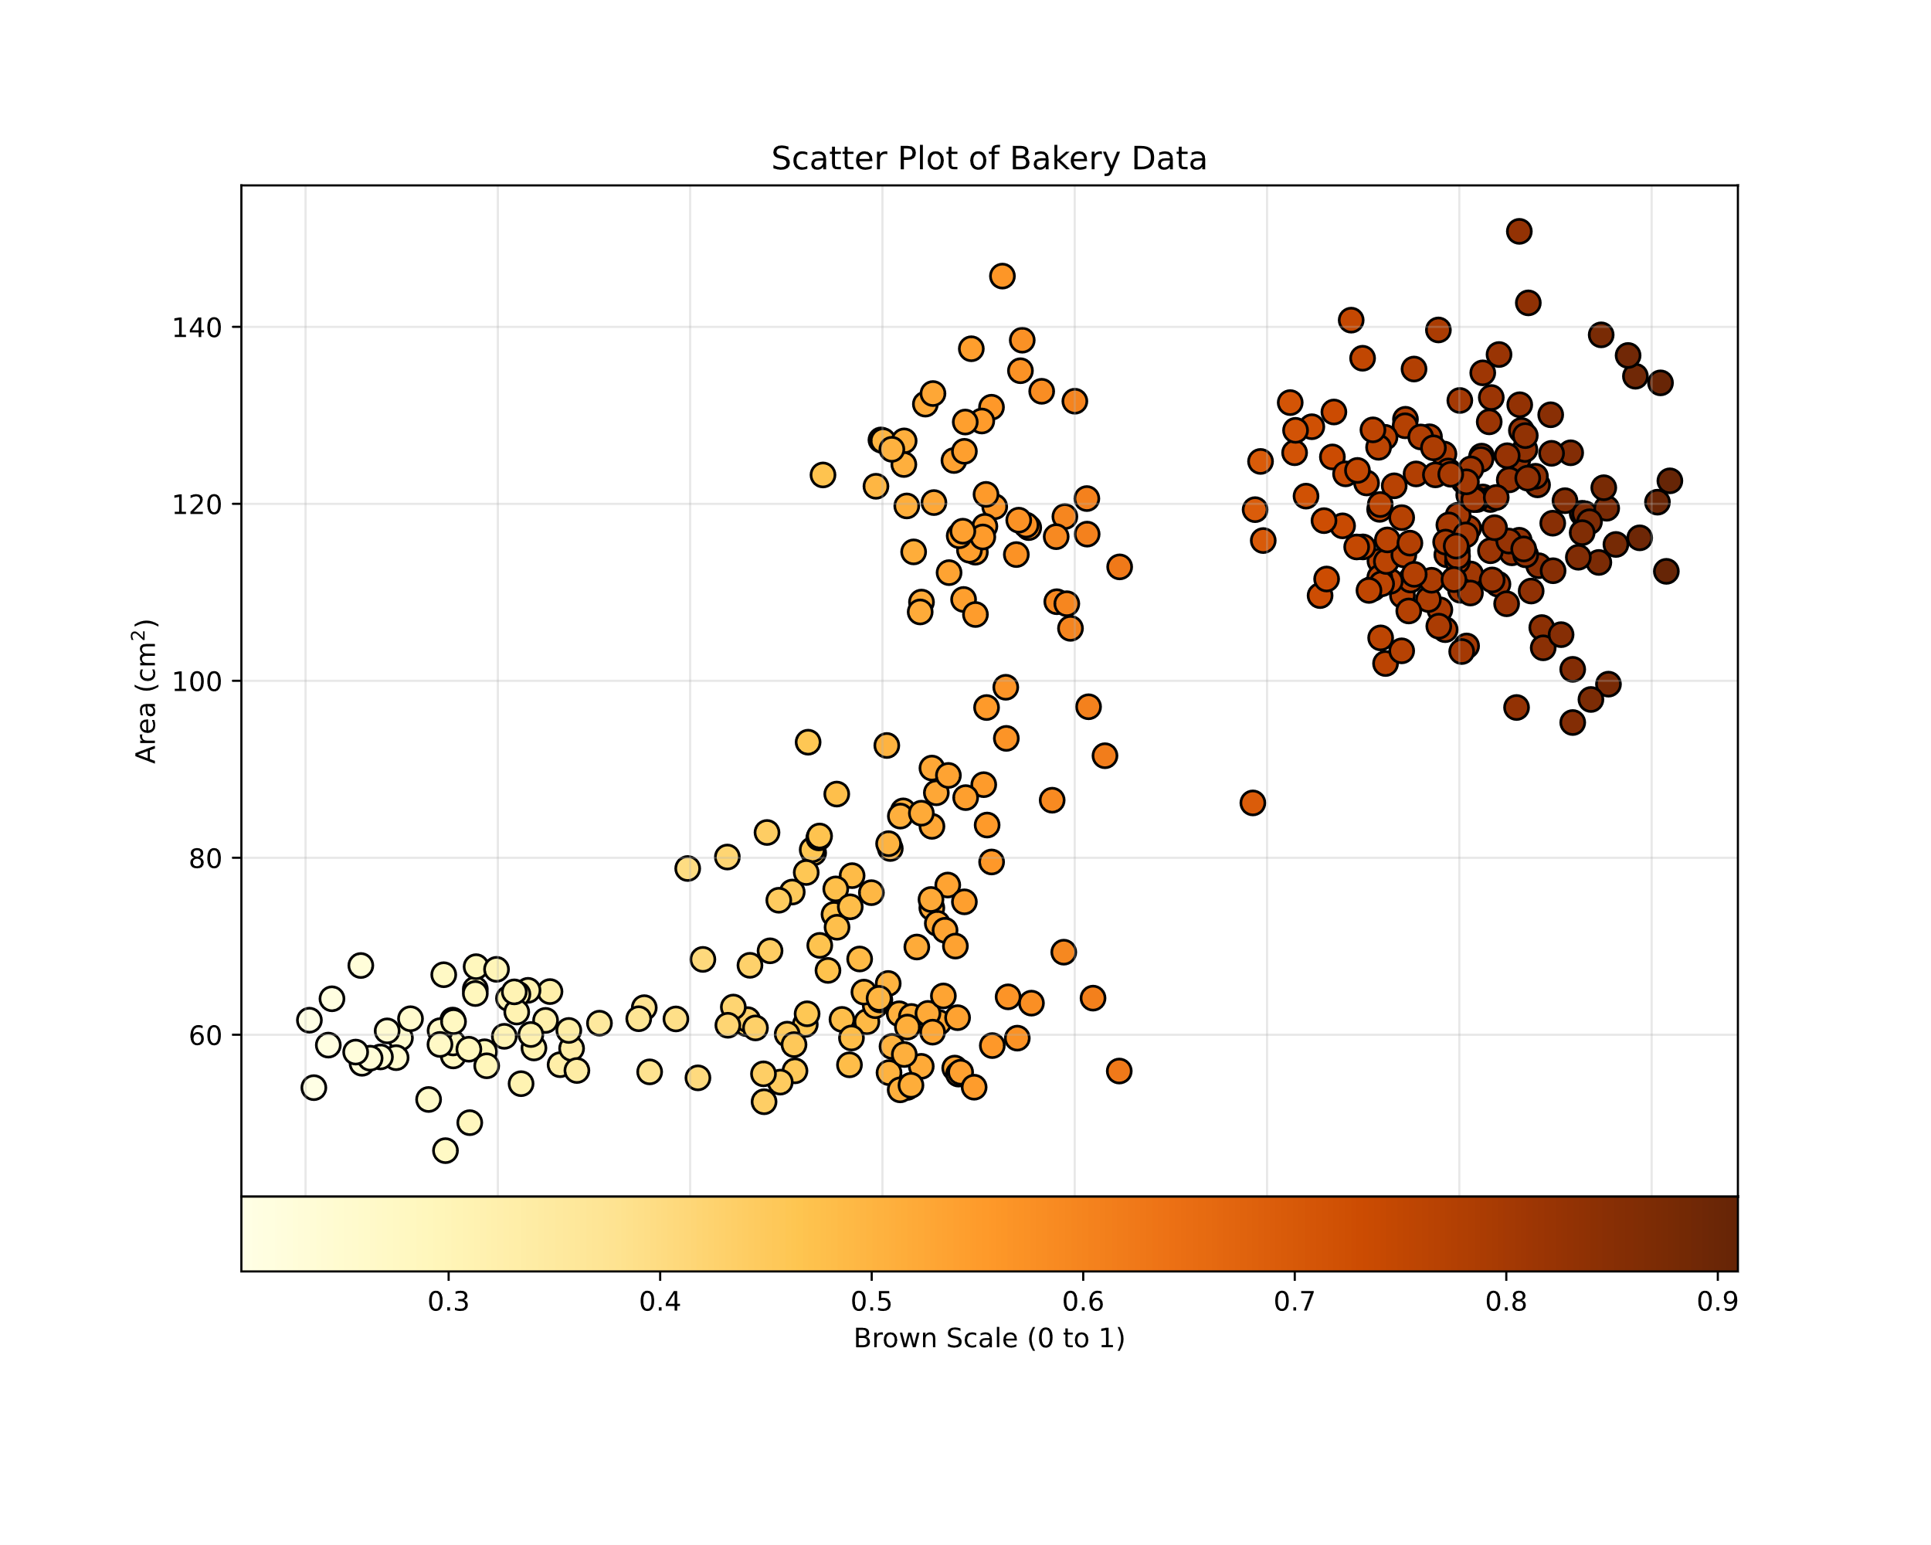
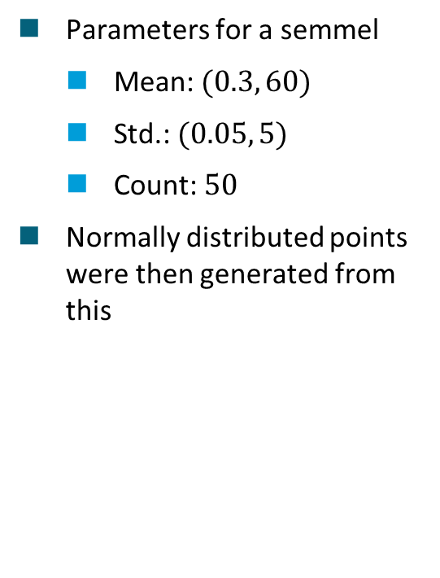
Background: Example
Parameters for a semmel
Mean: $(0.3, 60)$
Std.: $(0.05, 5)$
Count: $50$
Normally distributed points were then generated from this
Fig. 16: Plot of baked goods [6].

Slide 20
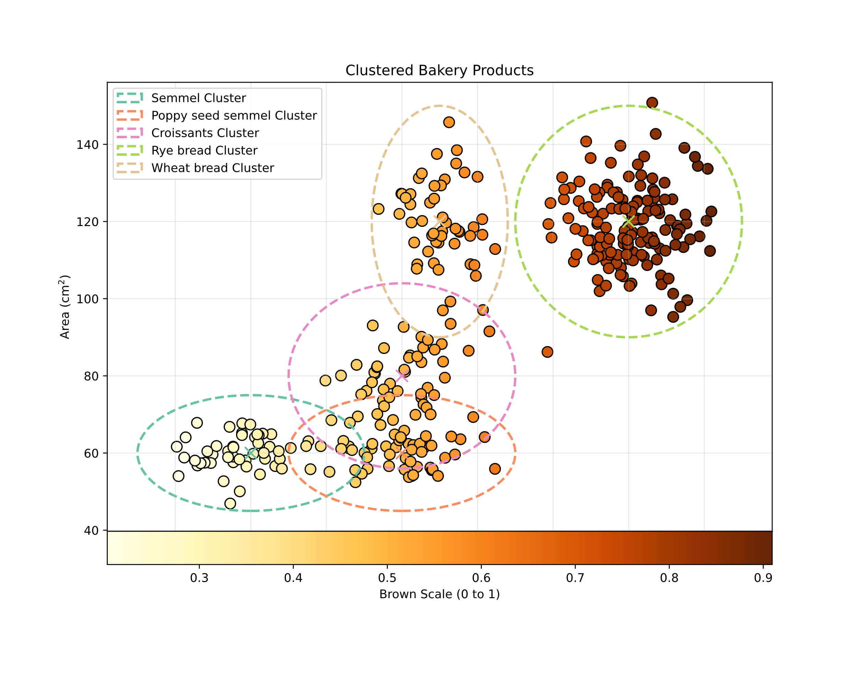
Background: Example
Plotting our data:
Semmel: 50
Poppy seed semmel: 50
Croissants: 50
Rye bread: 150
Wheat bread: 50
Fig. 17: Plot of baked goods with clusters [6].

Slide 21
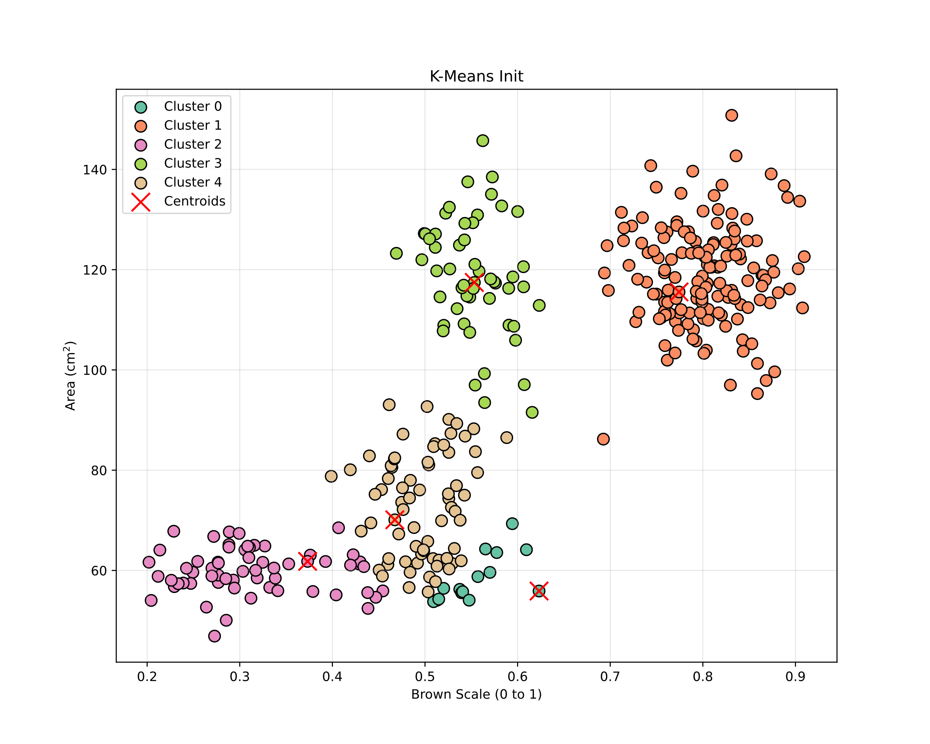
Background: Example
Fig. 18: Initialisation of the centroids [6].

Slide 22
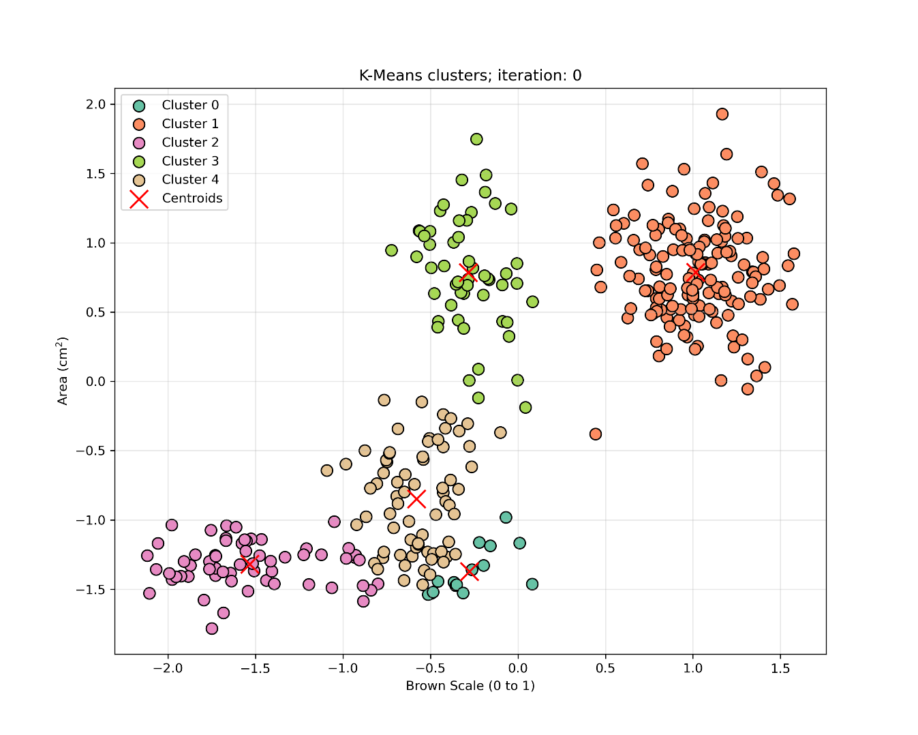
Background: Example
Fig. 19-0: K-Means iteration [6].

Slide 23
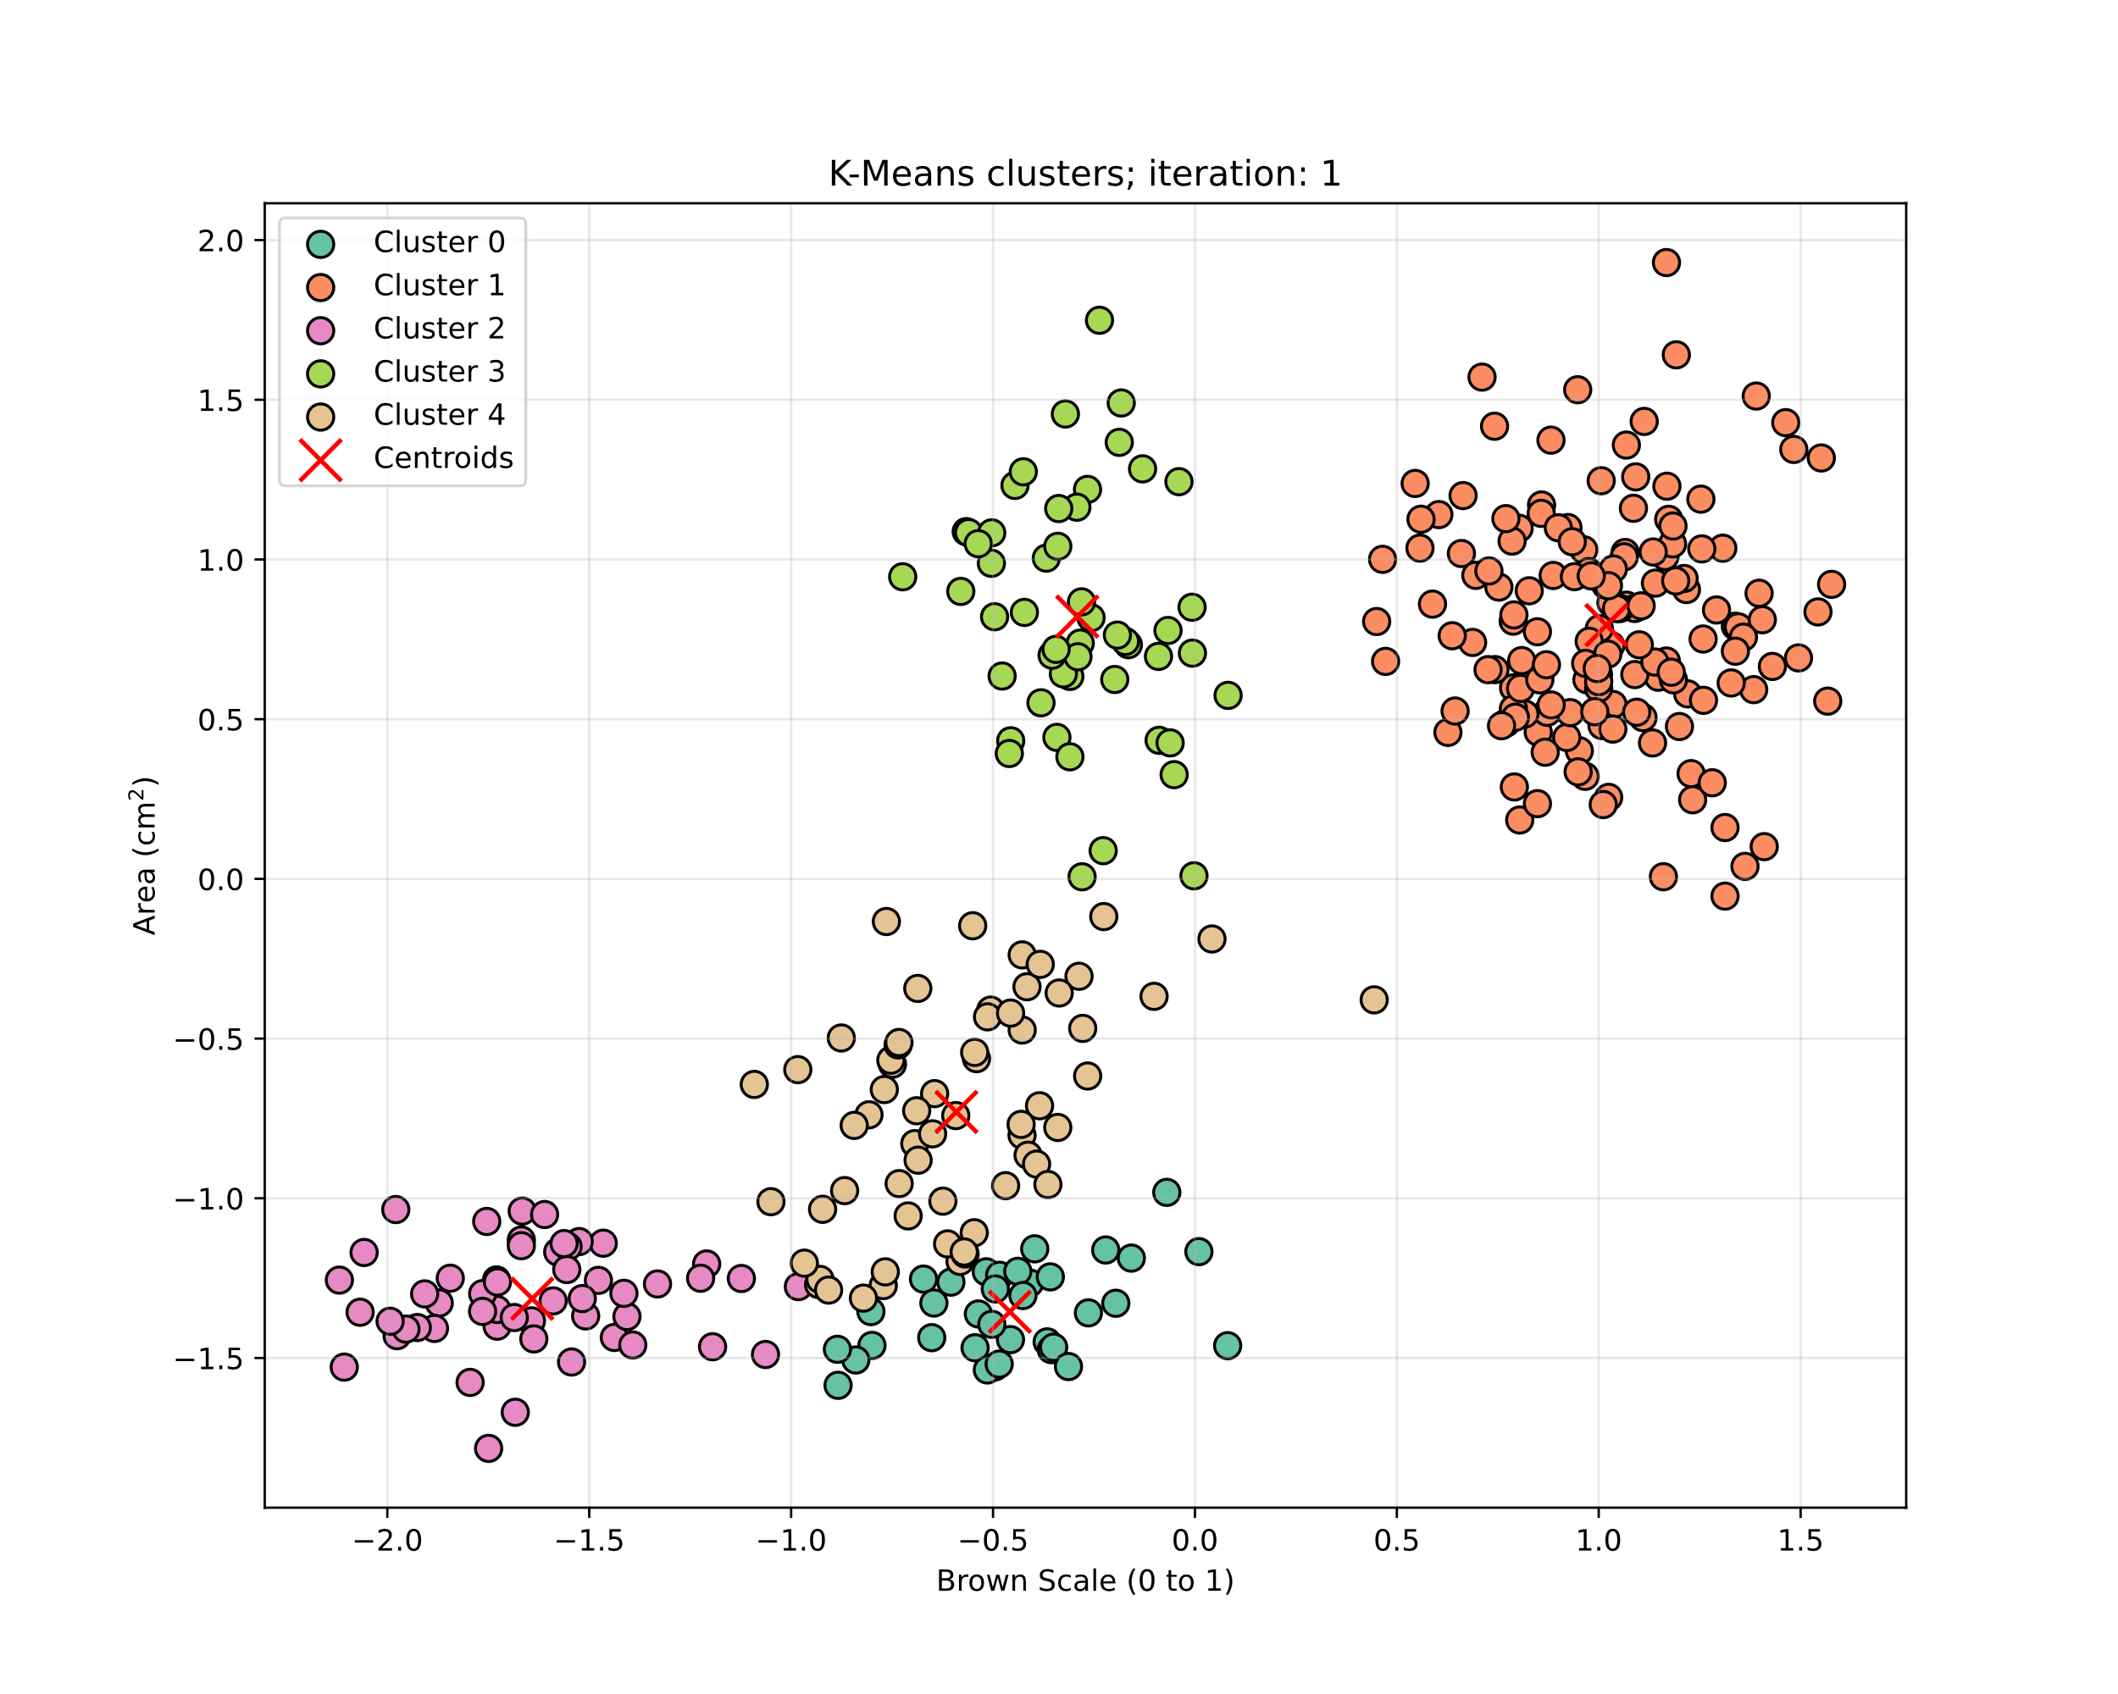
Background: Example
Fig. 19-1: K-Means iteration [6].

Slide 24

Background: Example
Fig. 19-2: K-Means iteration [6].

Slide 25

Background: Example
Fig. 19-3: K-Means iteration [6].

Slide 26

Background: Example
Fig. 19-4: K-Means iteration [6].

Slide 27

Background: Example
Fig. 19-5: K-Means iteration [6].

Slide 28

Background: Example
Fig. 19-6: K-Means iteration [6].

Slide 29

Background: Example
Fig. 20: K-Means results [6].

Slide 30
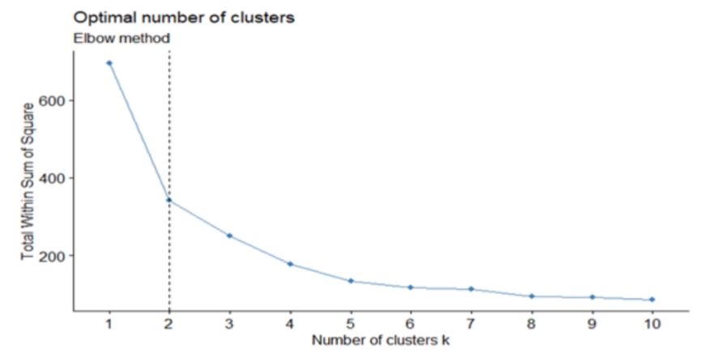
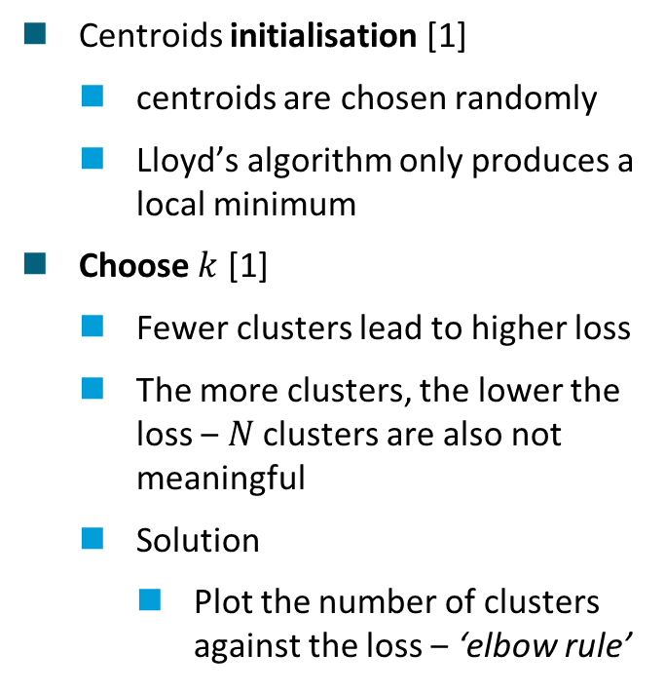
Background: Problems and limitations
Centroids initialisation [1]
centroids are chosen randomly
Lloyd’s algorithm only produces a local minimum
Choose $k$ [1]
Fewer clusters lead to higher loss
The more clusters, the lower the loss ‒ $N$ clusters are also not meaningful
Solution
Plot the number of clusters against the loss ‒ ‘elbow rule’
Fig. 21: Elbow-plot [7].

Slide 31
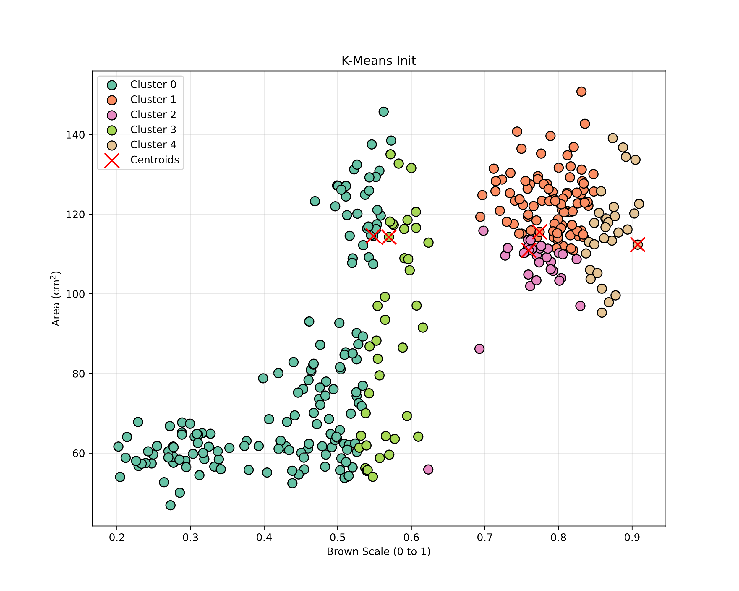
Background: Problems and limitations
Fig. 22-0: K-Means bad initialisation [6].

Slide 32
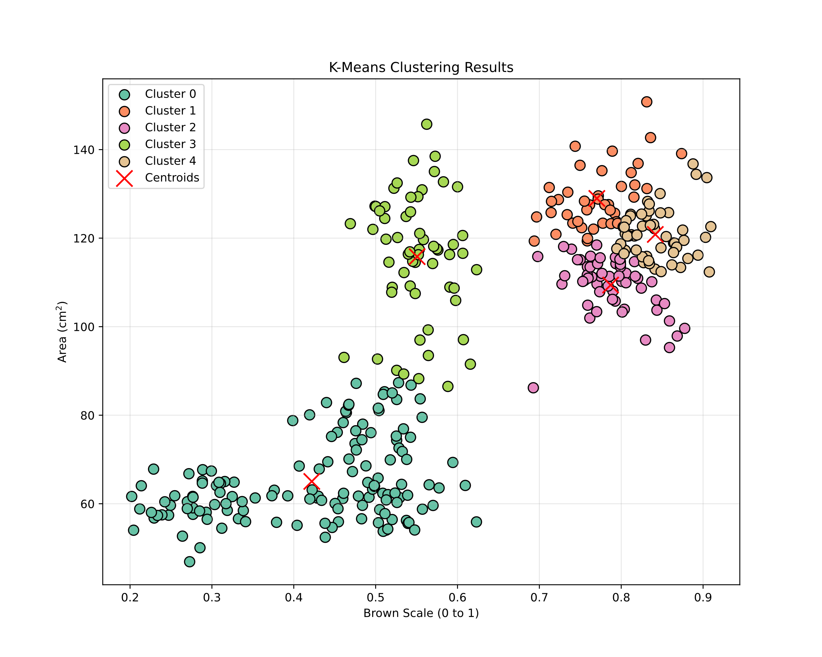
Background: Problems and limitations
Fig. 22-1: K-Means bad initialisation [6].

Slide 33
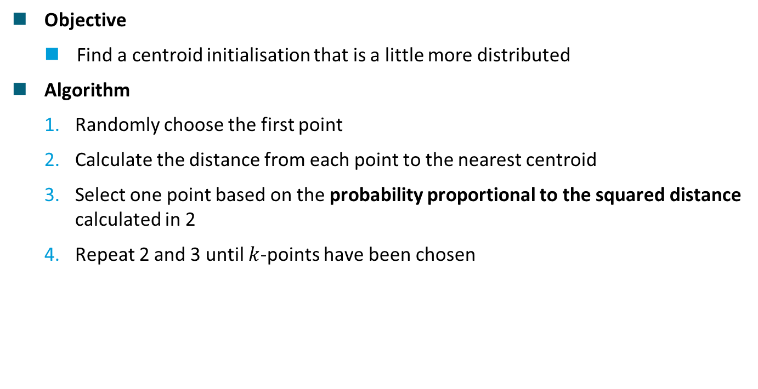
Background: K-Means++ [1]
Objective
Find a centroid initialisation that is a little more distributed
Algorithm
Randomly choose the first point
Calculate the distance from each point to the nearest centroid
Select one point based on the probability proportional to the squared distance calculated in 2
Repeat 2 and 3 until $k$-points have been chosen

Slide 34
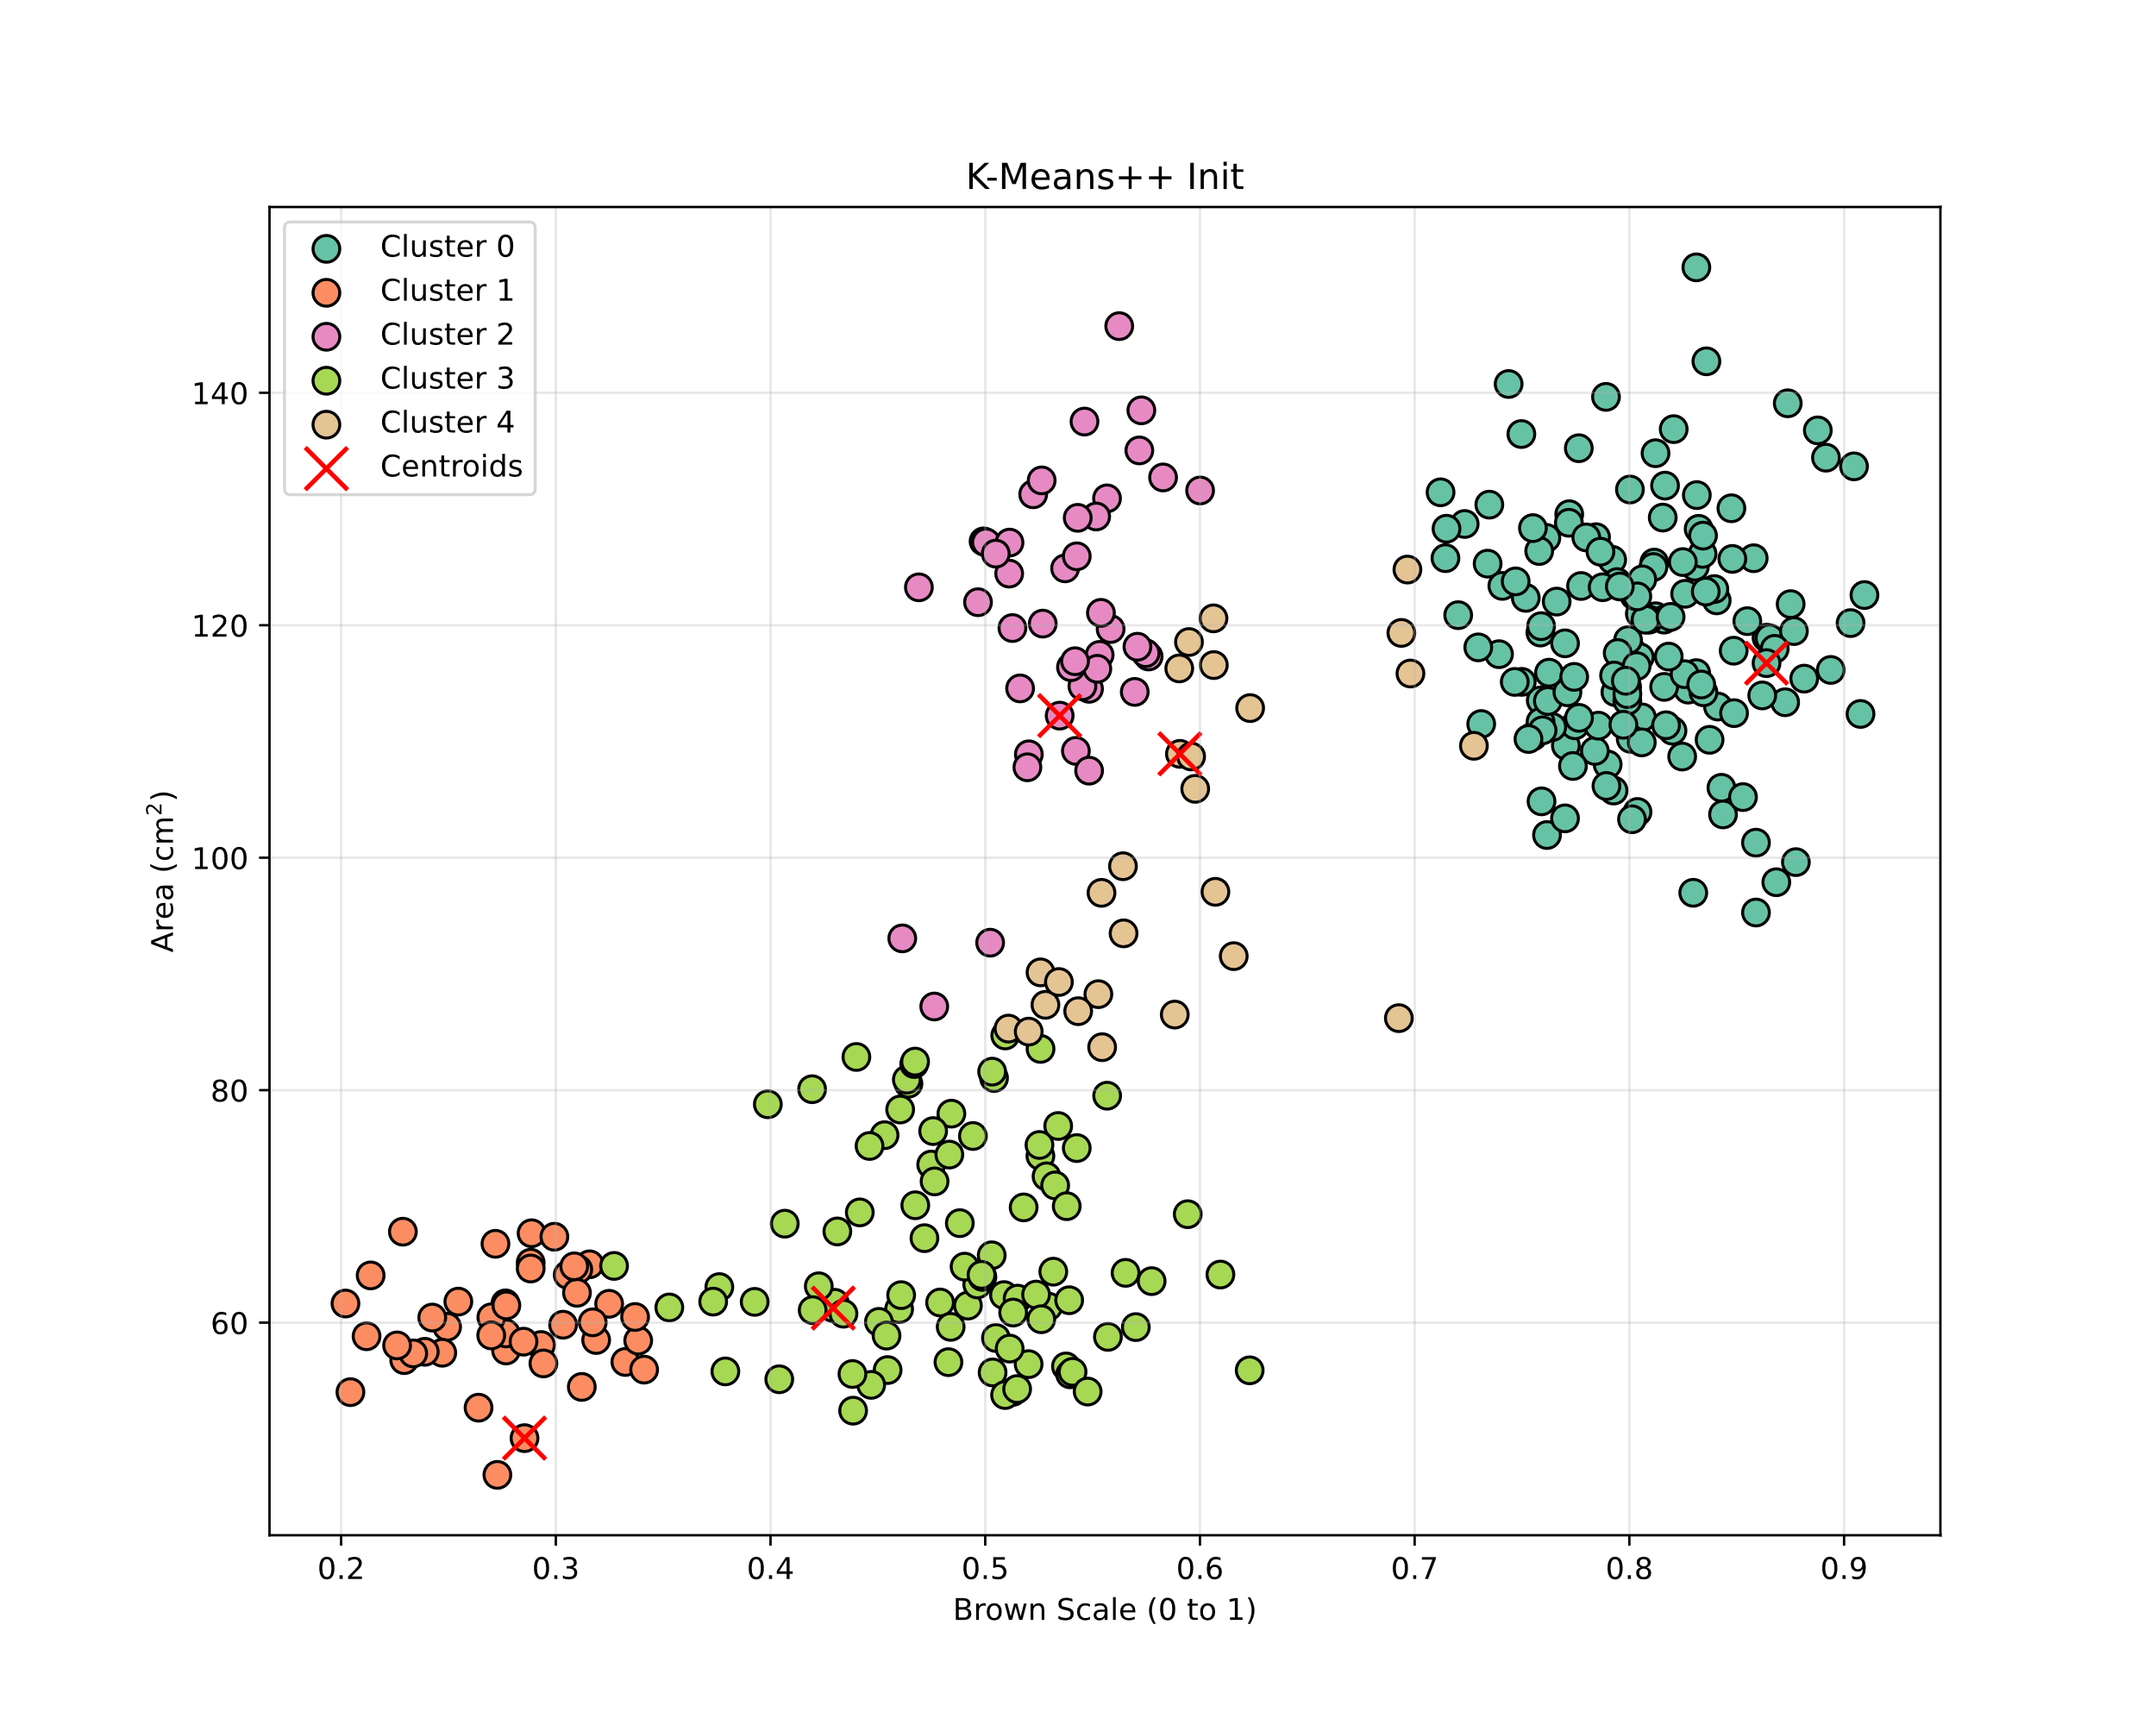
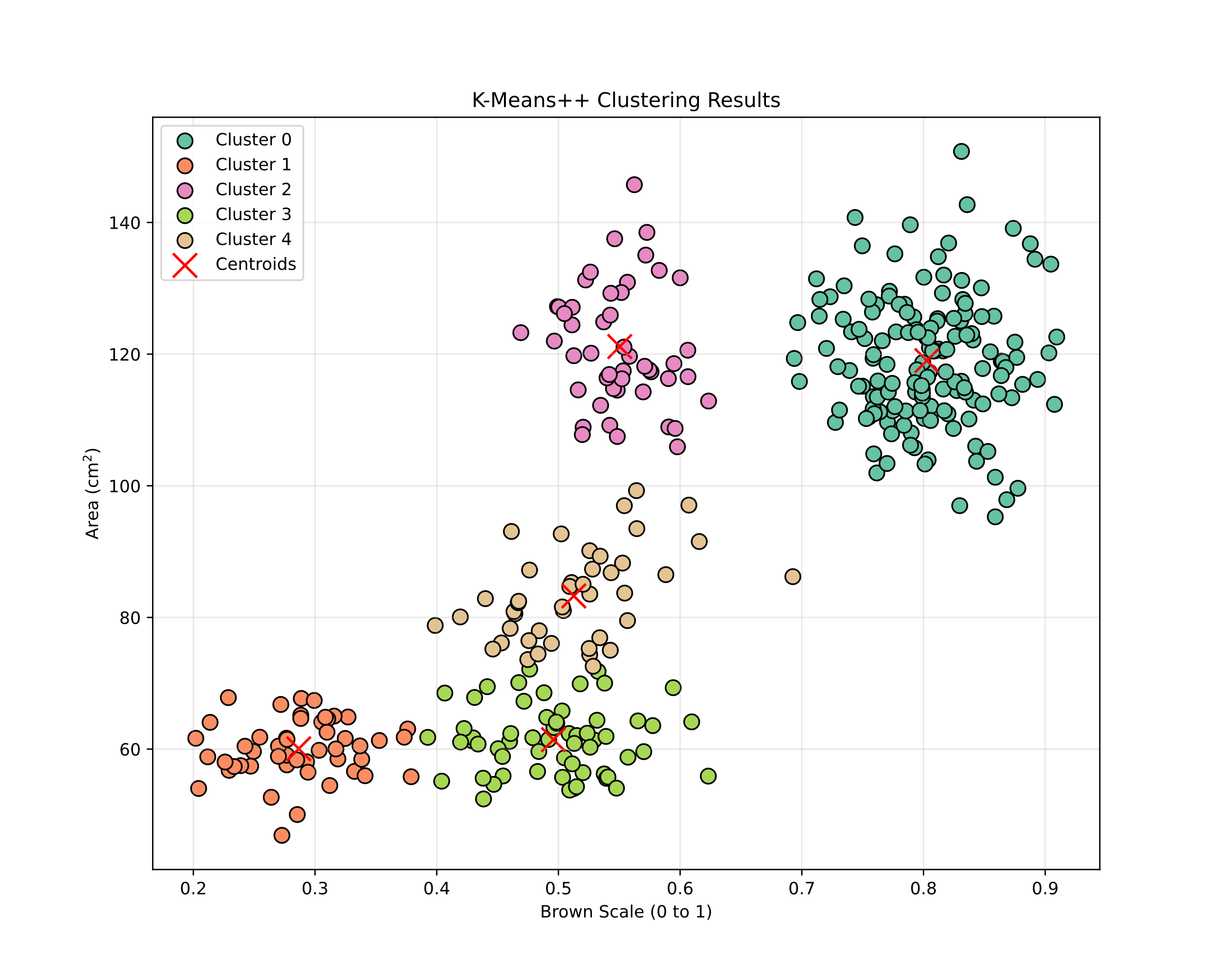
Background: K-Means++
Fig. 23-0: K-Means++ initialisation [6].
Fig. 23-1: K-Means++ results [6].

Slide 35
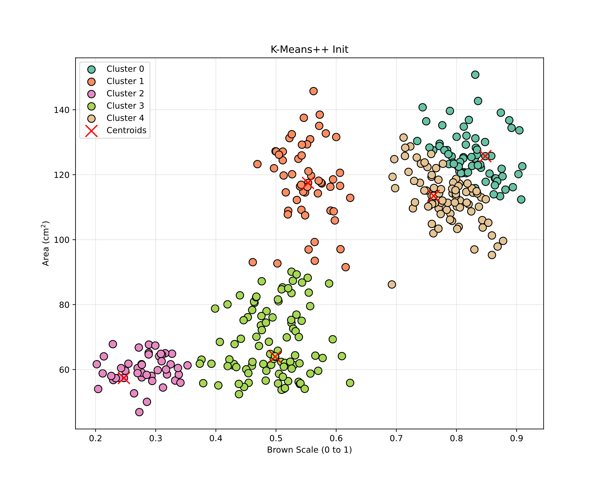
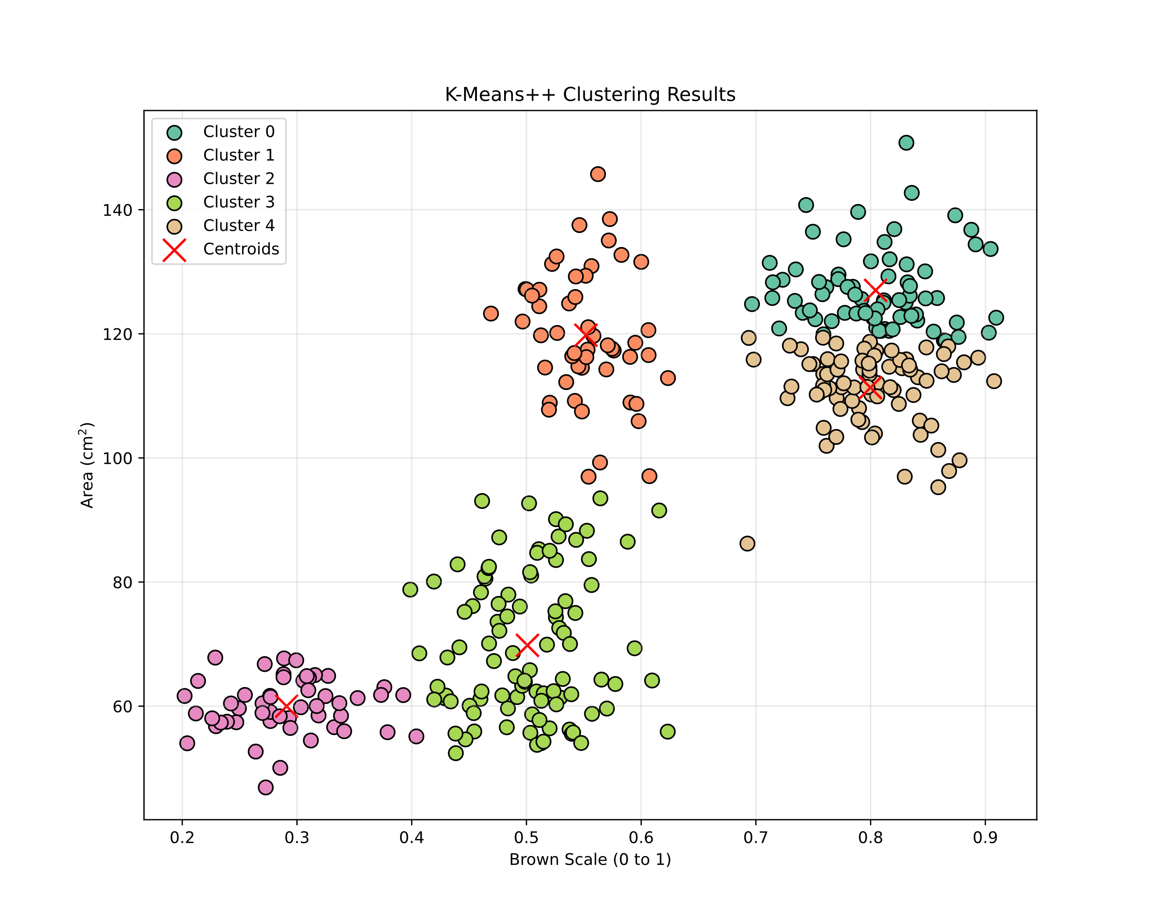
Background: K-Means++
Fig. 23-2: K-Means++ bad initialisation [6].
Fig. 23-3: K-Means++ bad results [6].

Slide 36
Challenges of K-Means
Problems
Performance depends on initial centroid placement
Even K-Means++ doesn’t guarantee optimal results
Poor initialization causes suboptimal clusters, slower convergence, or local minima
Challenges with Current Solutions [8]
Run the algorithm repeatedly and take the best result
This strategy significantly increases computational cost
Need for Improvement
Efficient methods are needed for better clustering without high computational cost

Slide 37
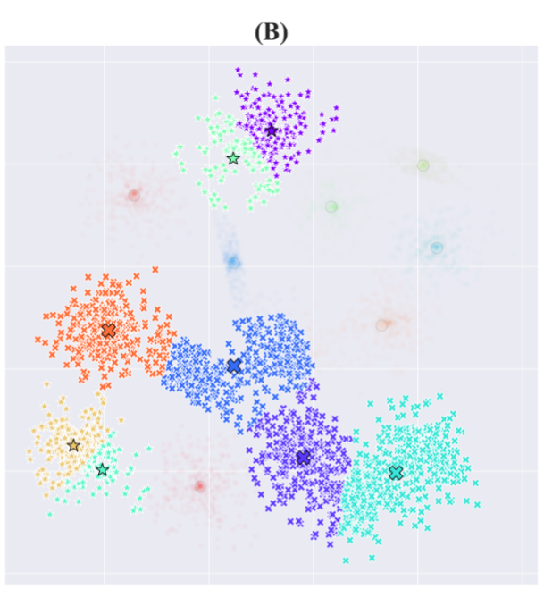
Statistically improving K-Means: Identifying issues
Identifying two issues [8]
Mega Clusters
Multiple groupings merged into one cluster due to missing centroids
Conflicting Clusters
A single cluster split into multiple
Caused by too many centroids in that region
Fig. 24: Mega- and Conflicting Clusters [8].

Slide 38
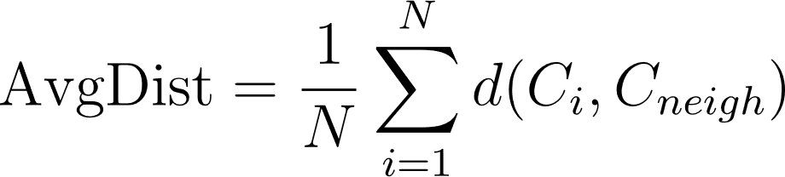
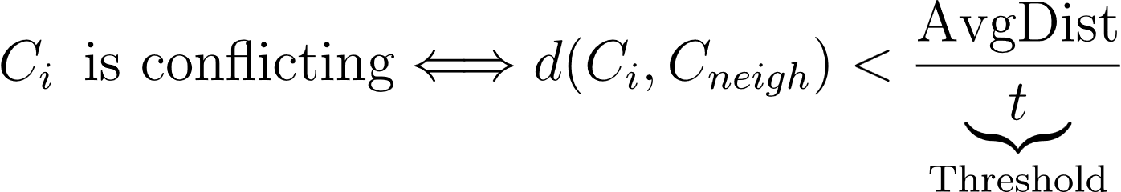
Statistically improving K-Means: Identifying issues
Identifying Conflicting Clusters [8]
Calculating the average distance between all centroids
Pairs of centroids that are very close to each other are identified as conflicting centroids

Slide 39
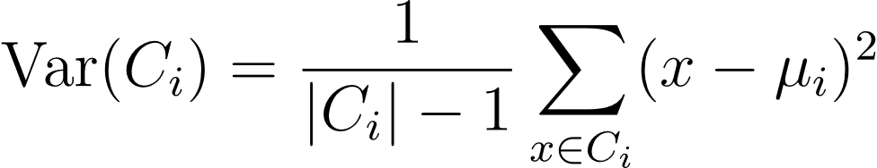
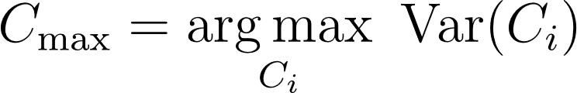
Statistically improving K-Means: Identifying issues
Identifying Mega Cluster [8]
Calculating the variance of a cluster
The centroid with the highest variance is selected as Mega Cluster

Slide 40
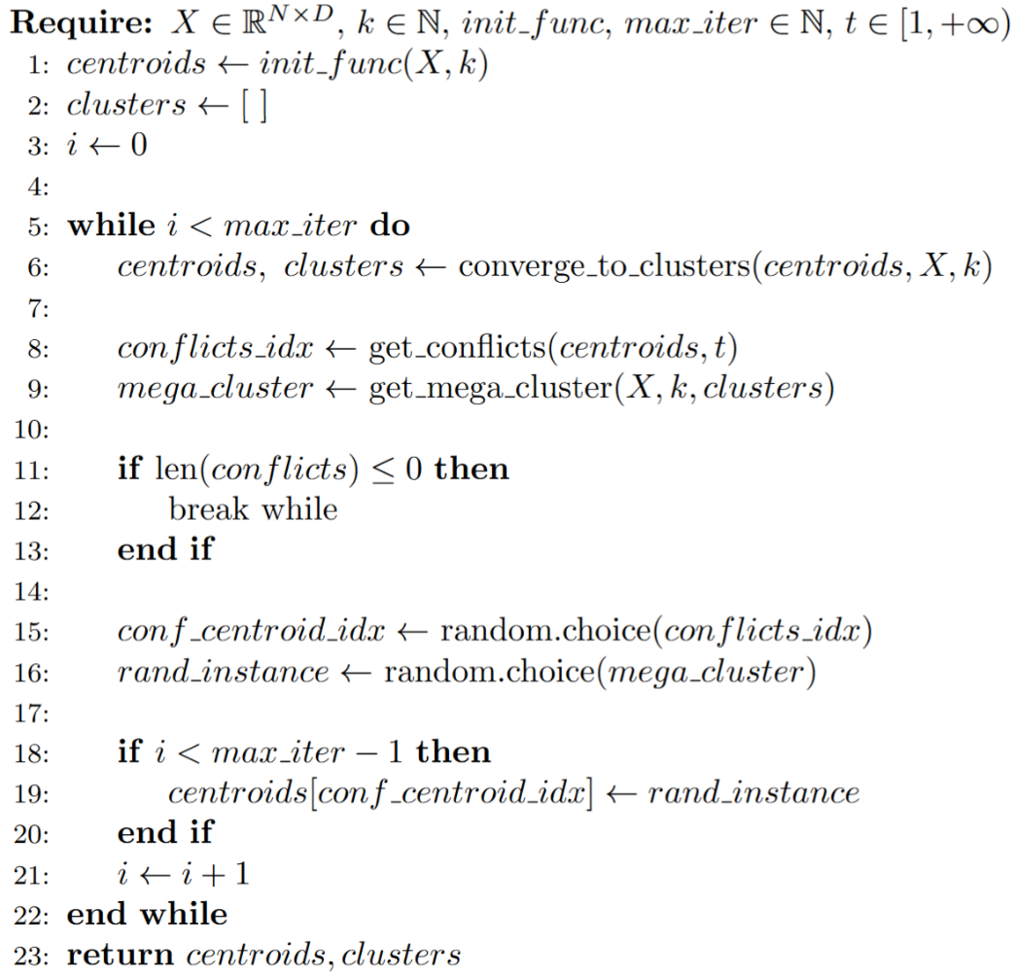
Statistically improving K-Means: Algorithm
The improved Algorithm [8]
Run K-Means(++)
Identify conflicts
Identify mega cluster
Place conflicting centroid into mega cluster

Slide 41
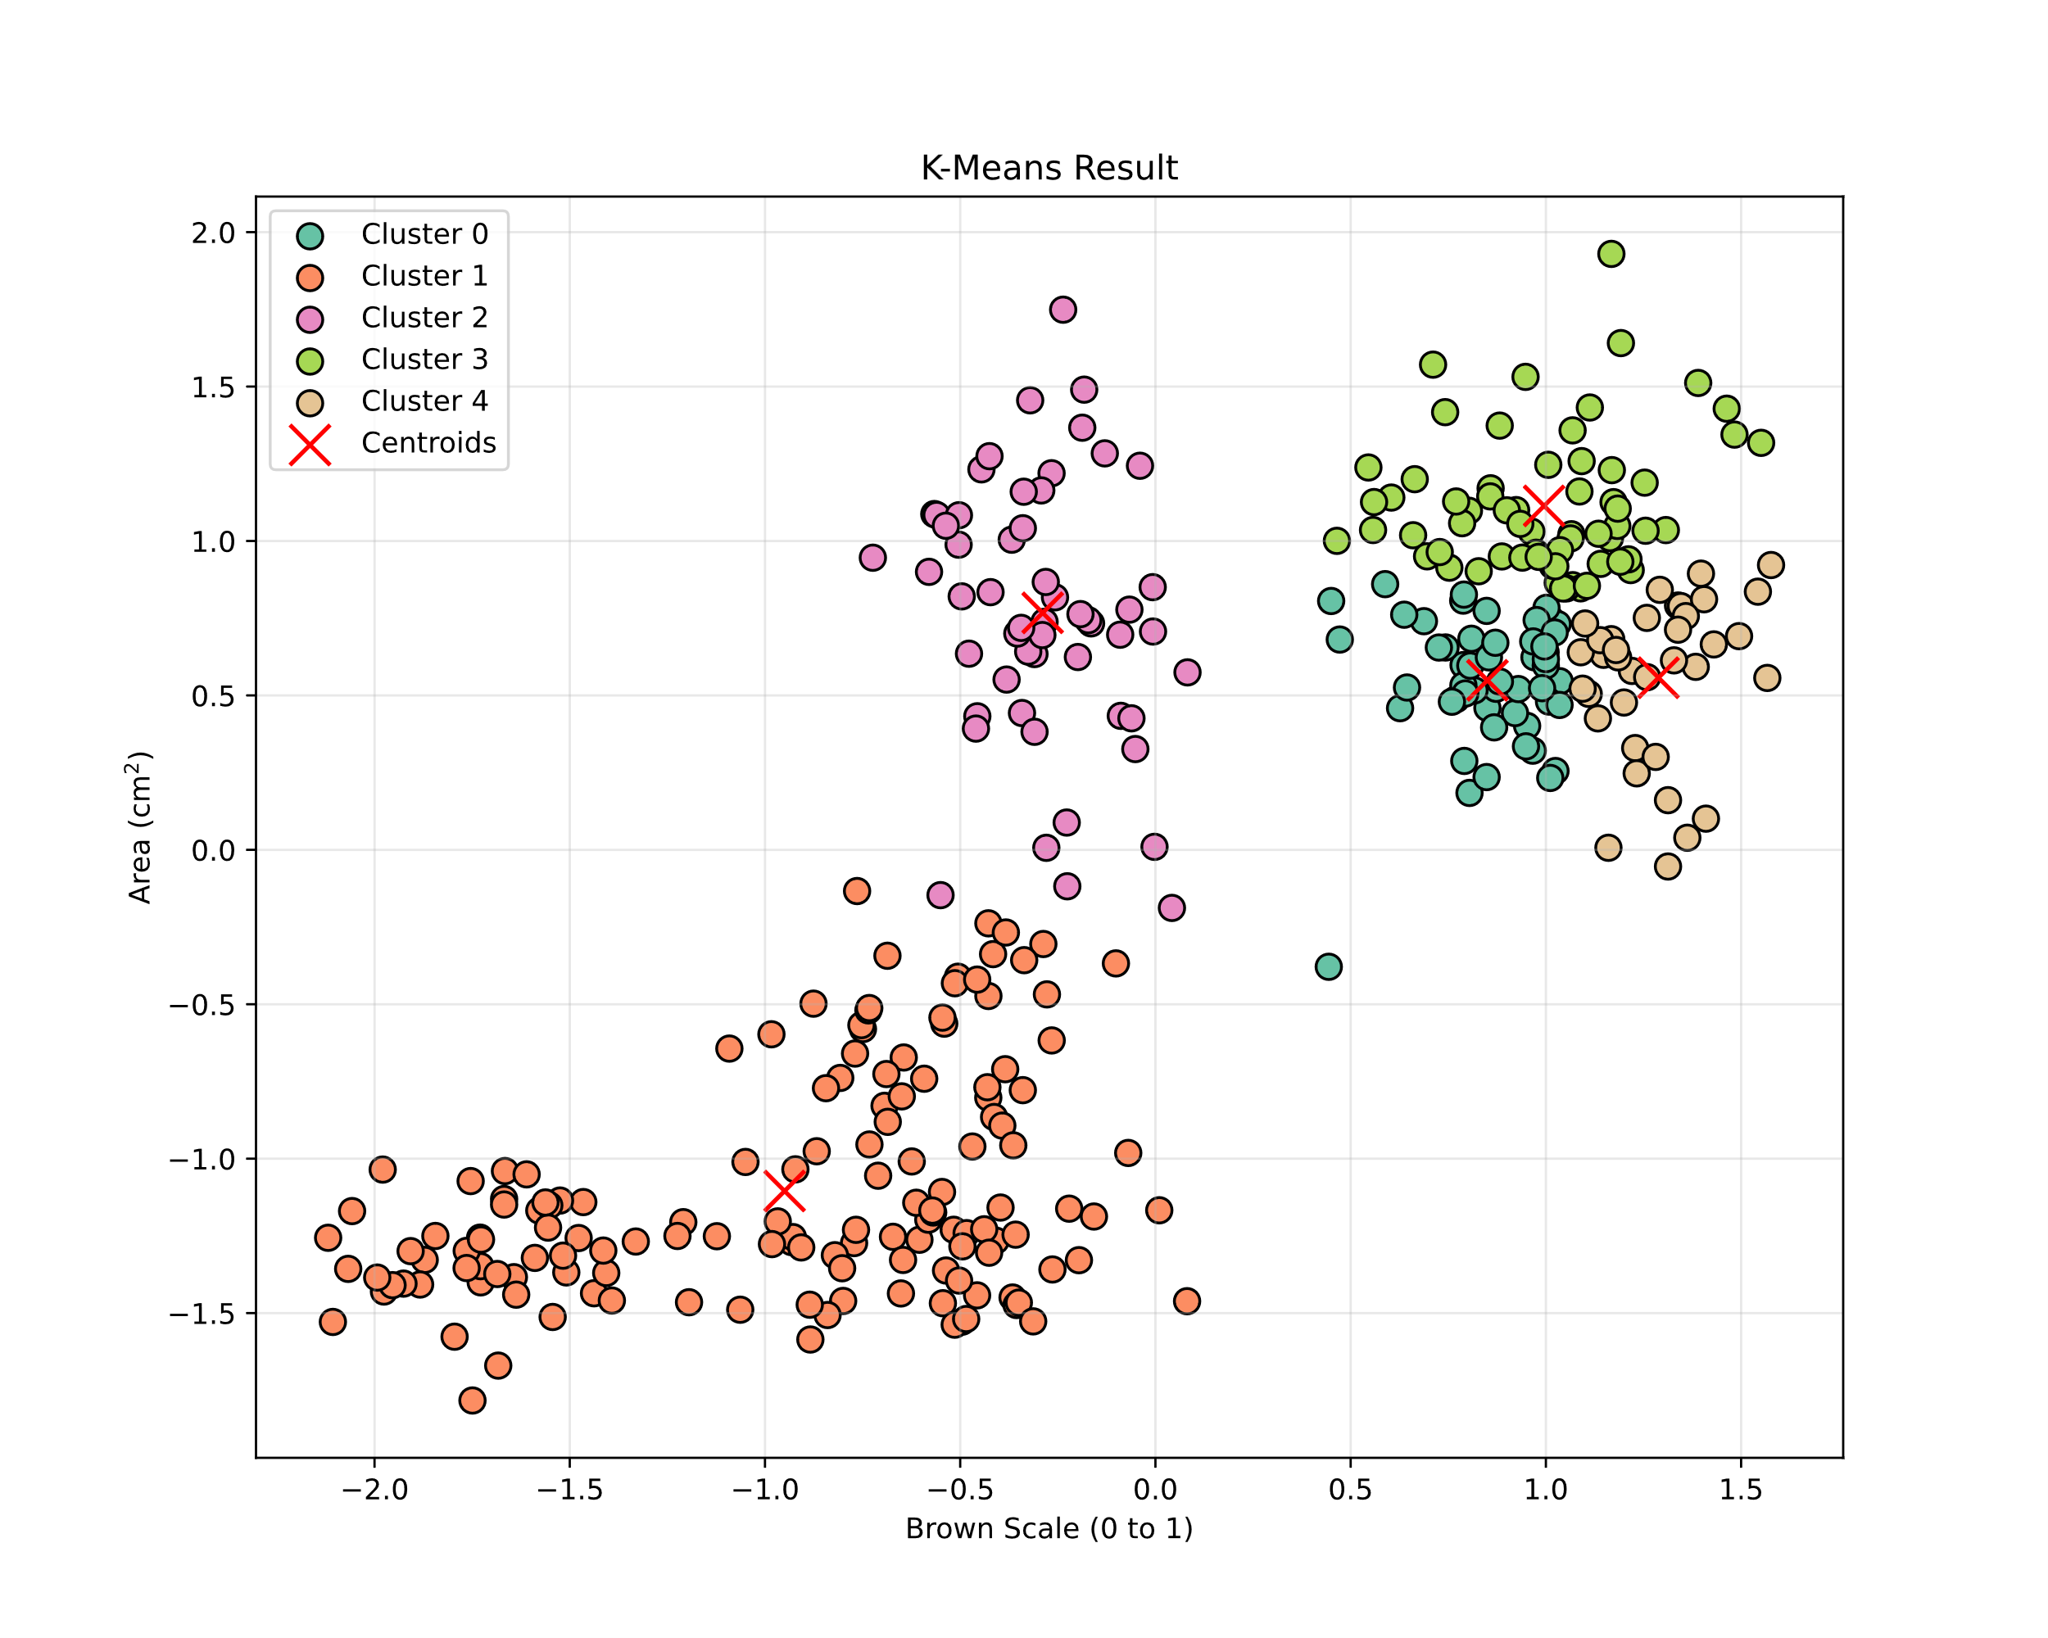
Statistically improving K-Means: Visualisation
Fig. 25-0: K-Means result [6].

Slide 42
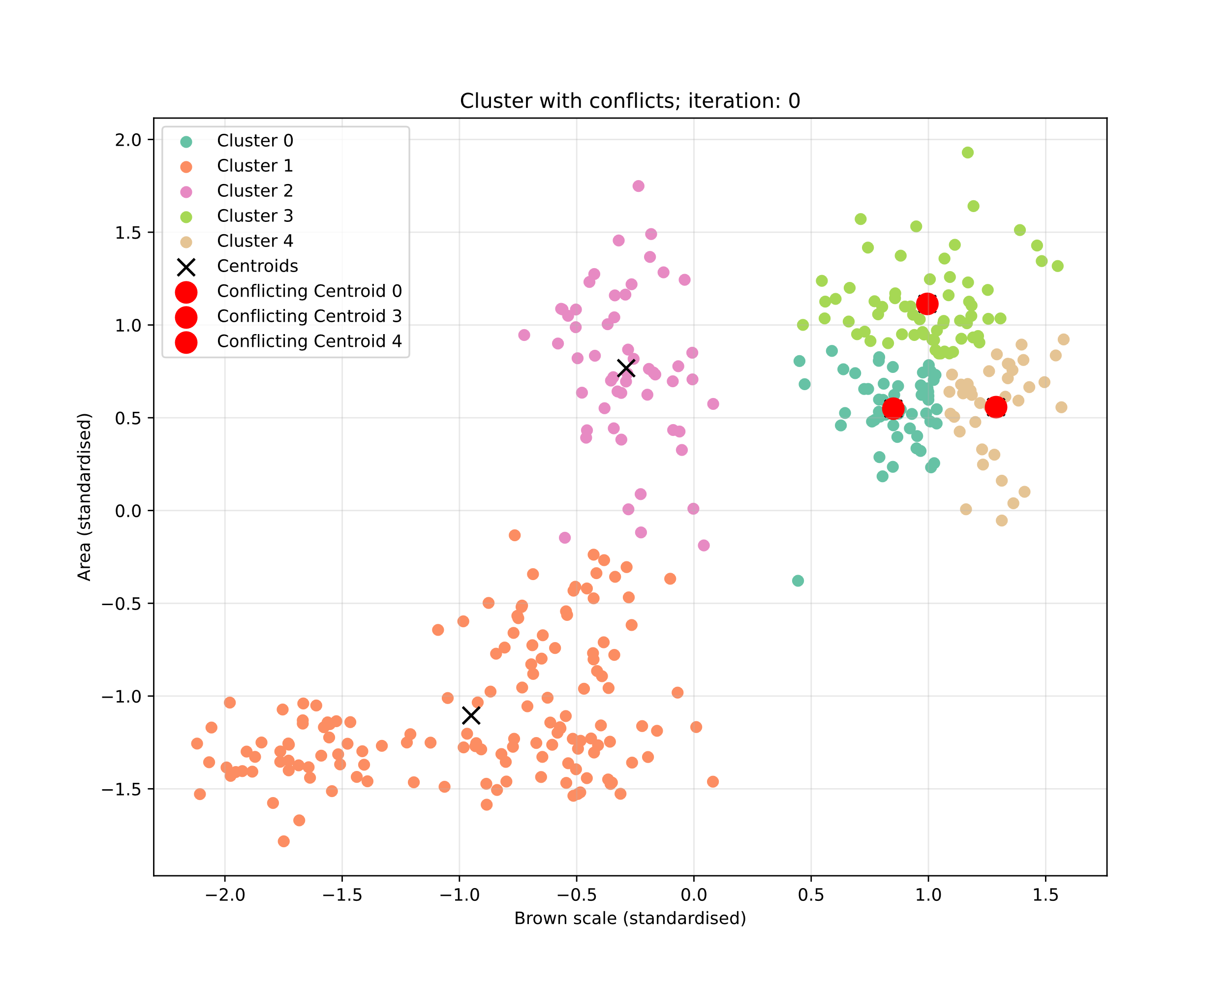
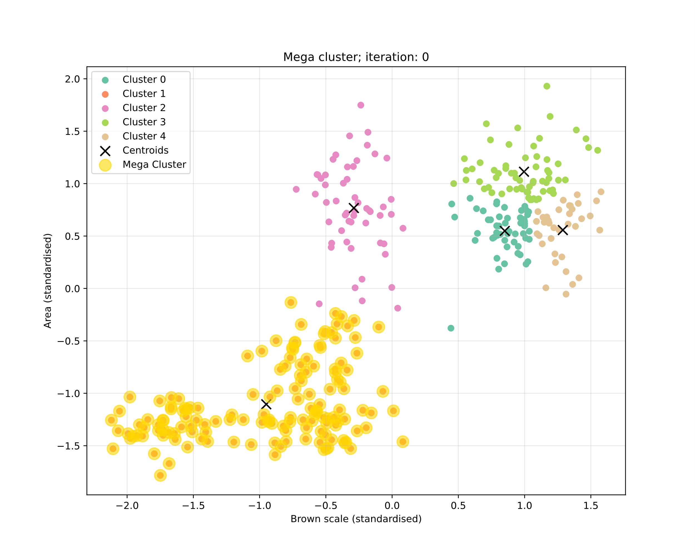
Statistically improving K-Means: Visualisation
Fig. 25-1: Conflicting clusters; Iteration 0 [6].
Fig. 25-2: Mega cluster;
Iteration 0 [6].

Slide 43
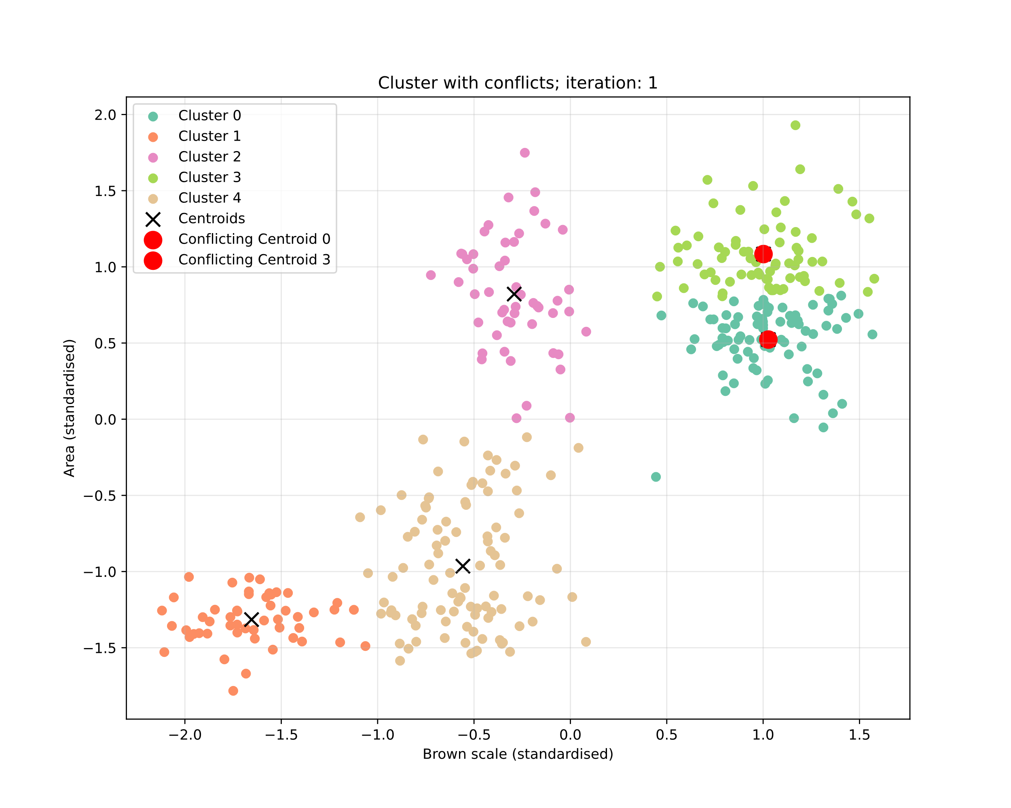
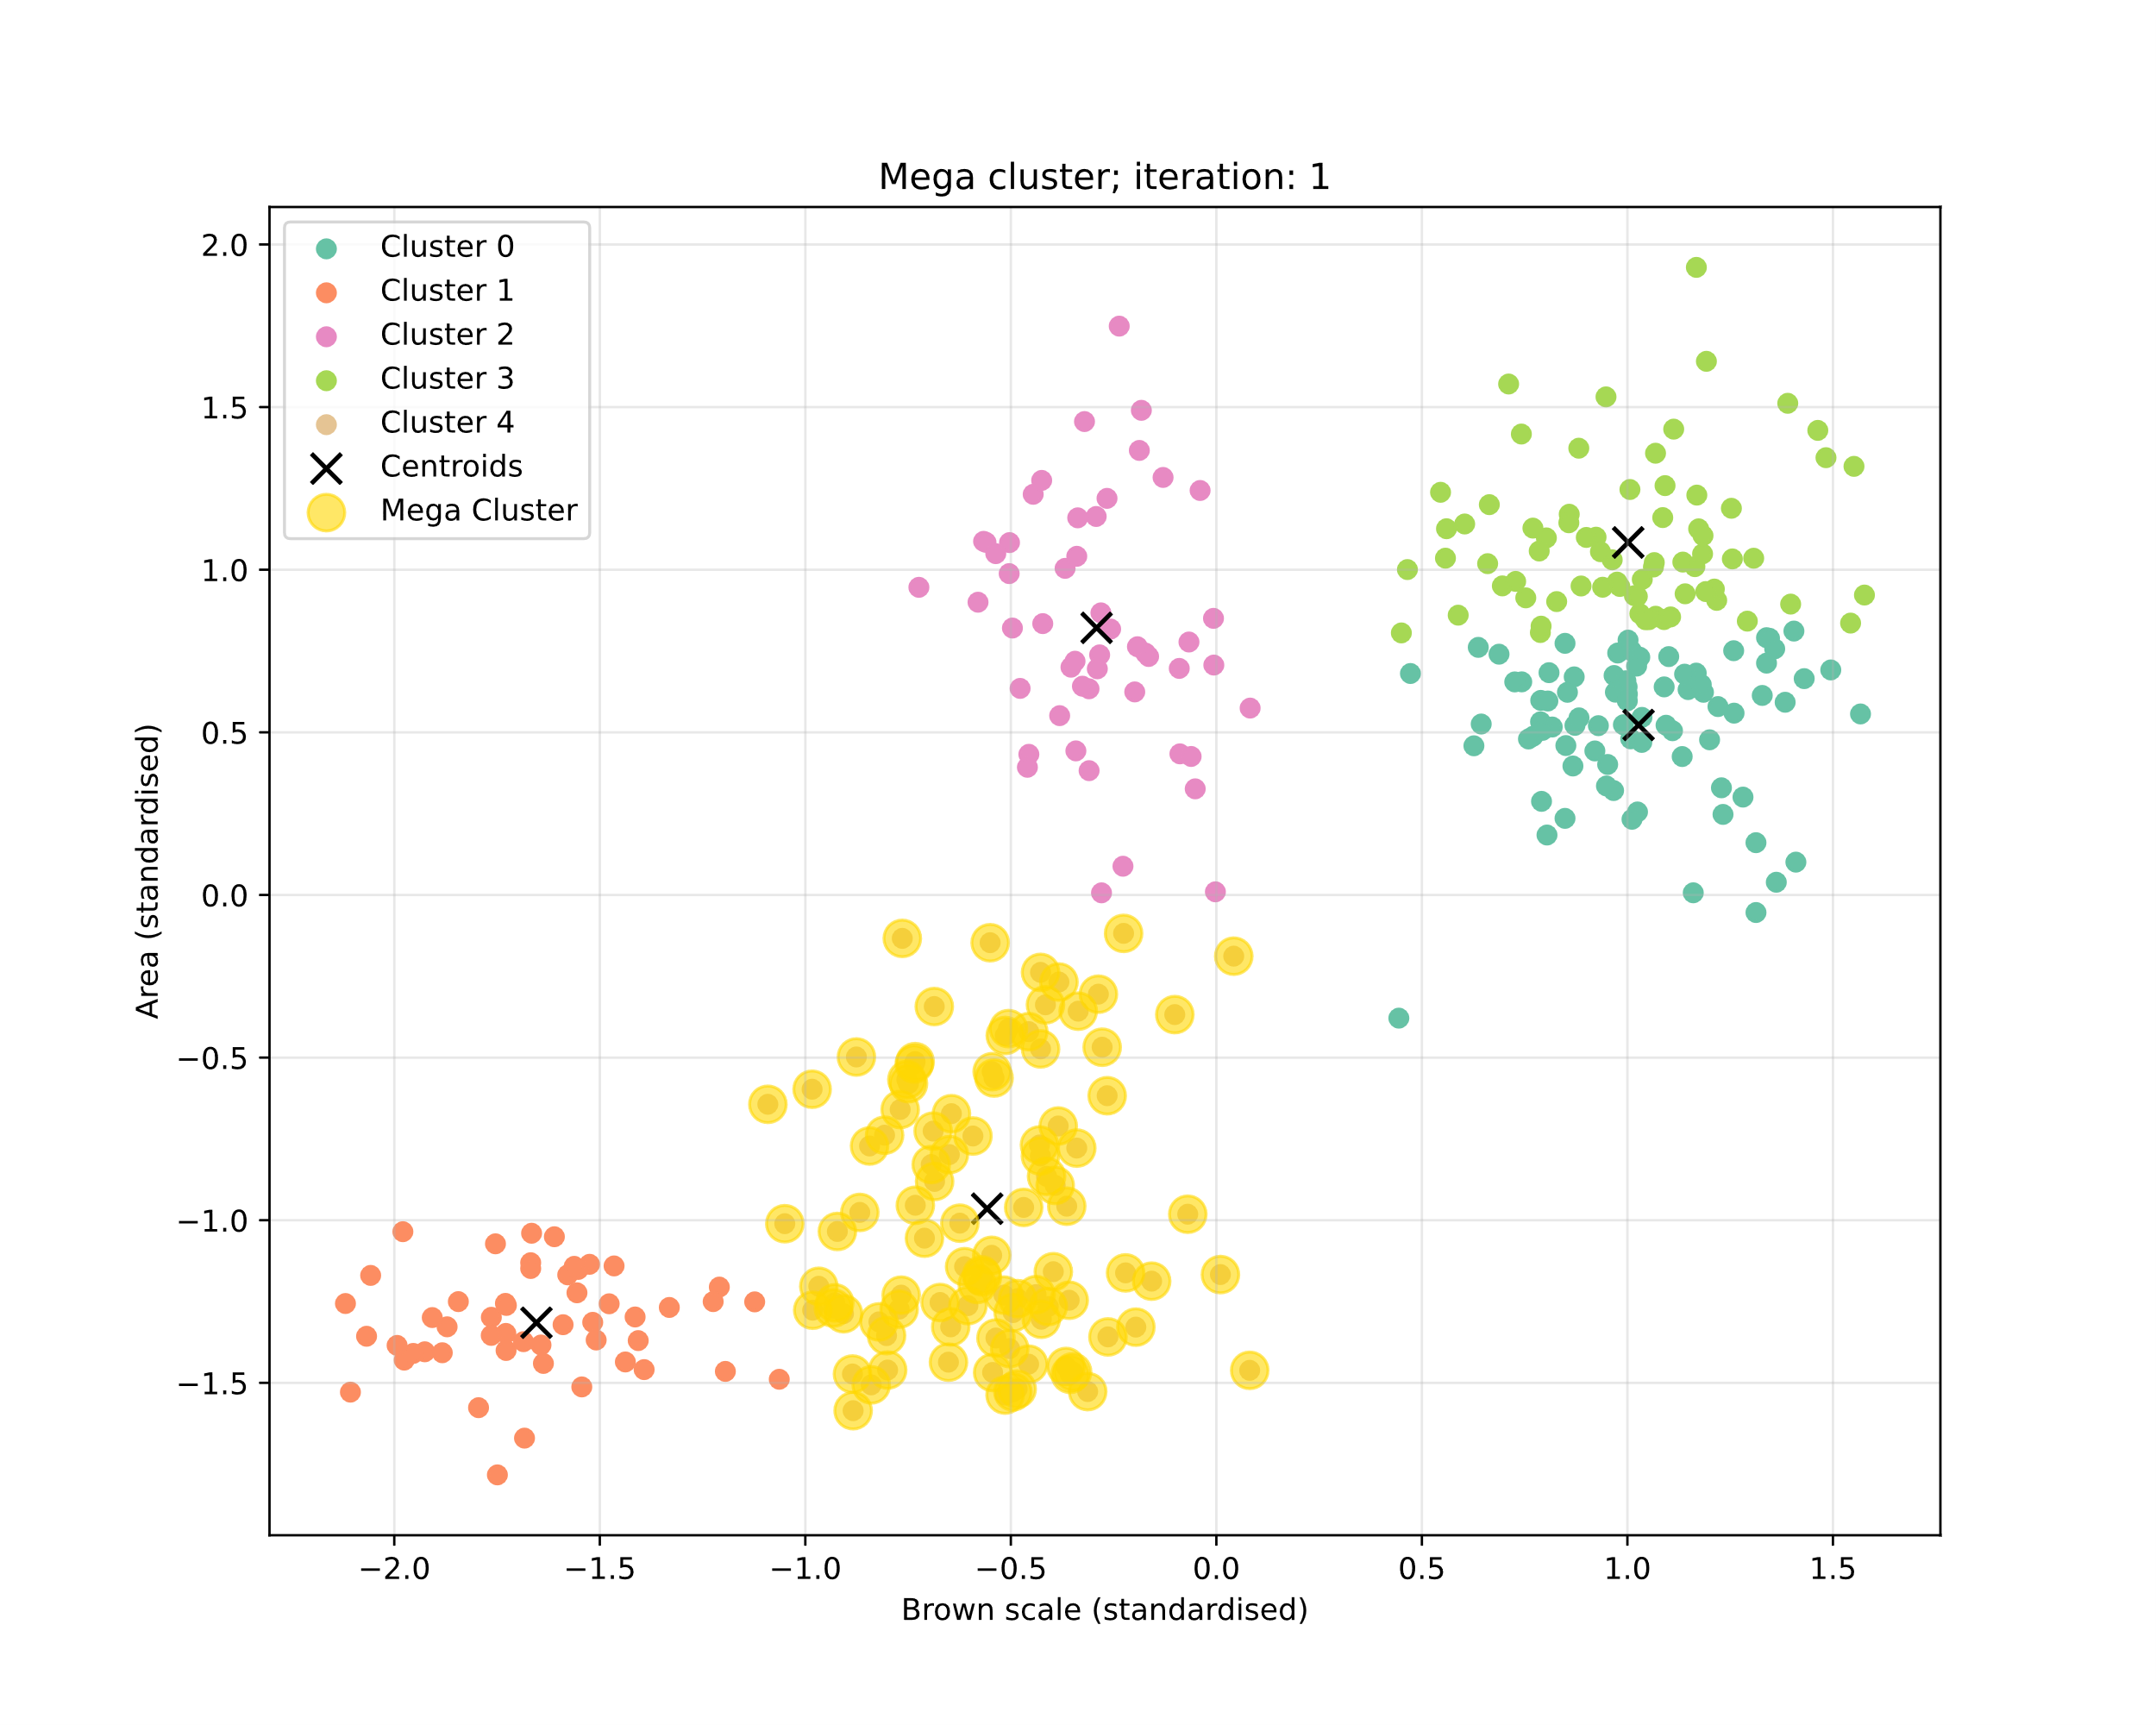
Statistically improving K-Means: Visualisation
Fig. 25-3: Conflicting clusters;
Iteration 1 [6].
Fig. 25-4: Mega cluster;
Iteration 1 [6].

Slide 44
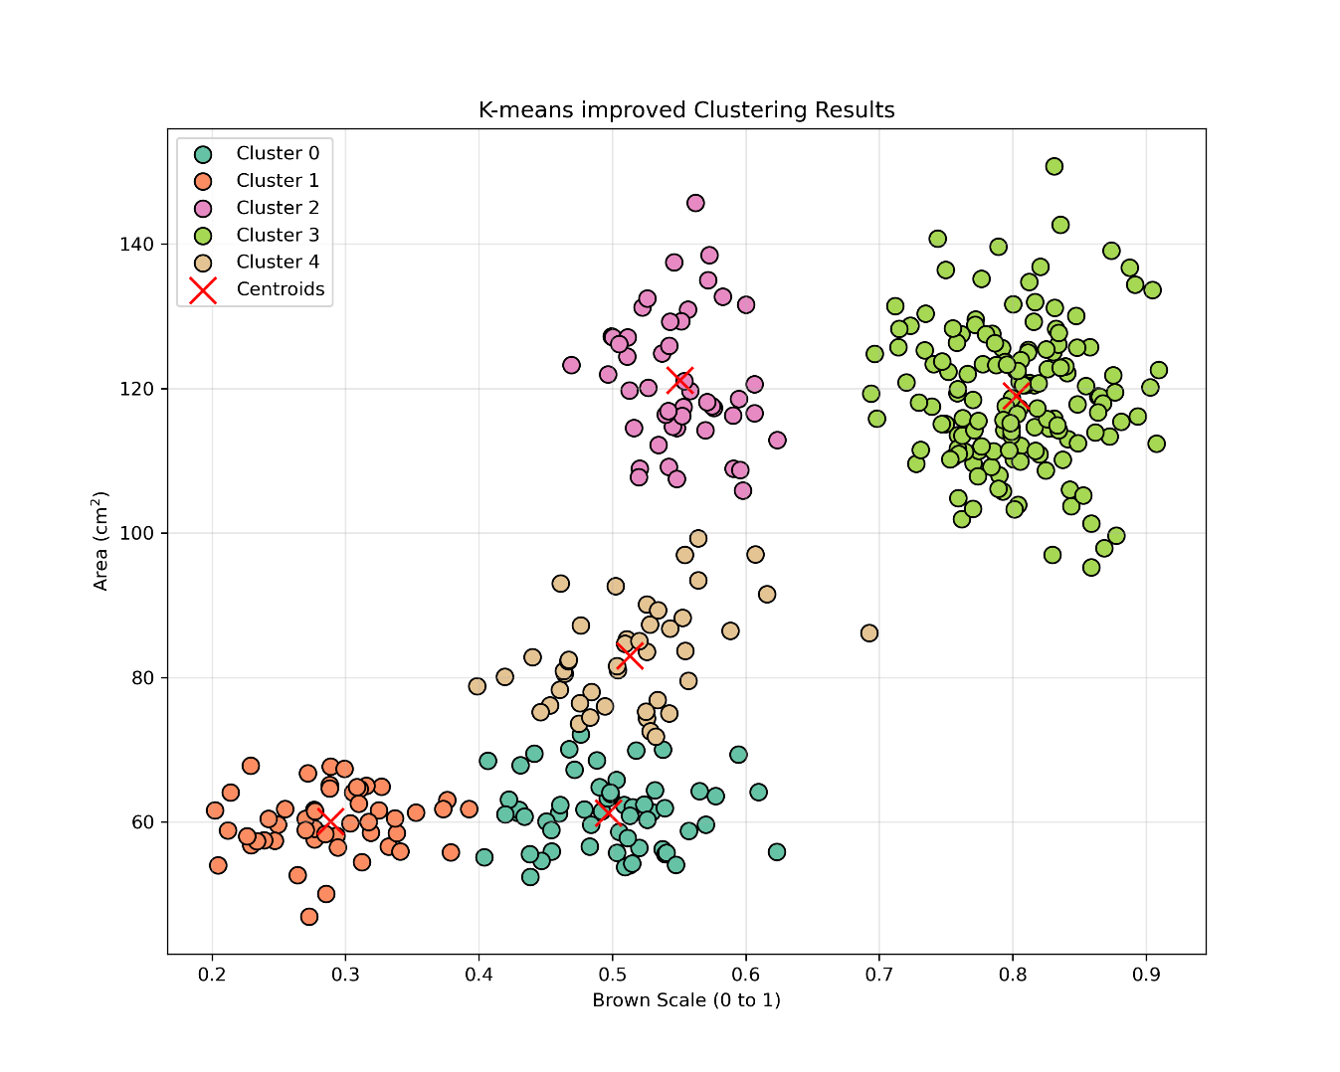
Statistically improving K-Means: Visualisation
Fig. 25-6: Improved Algorithm results [6].

Slide 45
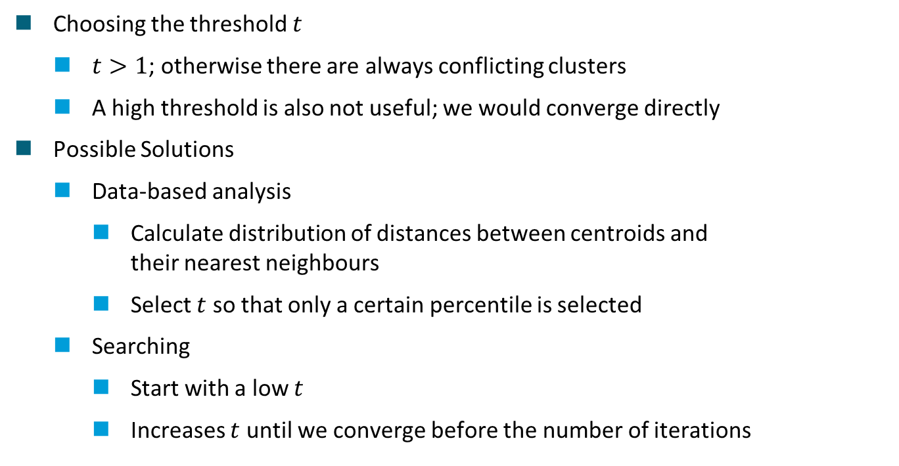
Statistically improving K-Means: Hyperparameter
Choosing the threshold $t$
$t>1$; otherwise there are always conflicting clusters
A high threshold is also not useful; we would converge directly
Possible Solutions
Data-based analysis
Calculate distribution of distances between centroids and their nearest neighbours
Select $t$ so that only a certain percentile is selected
Searching
Start with a low $t$
Increases $t$ until we converge before the number of iterations

Slide 46
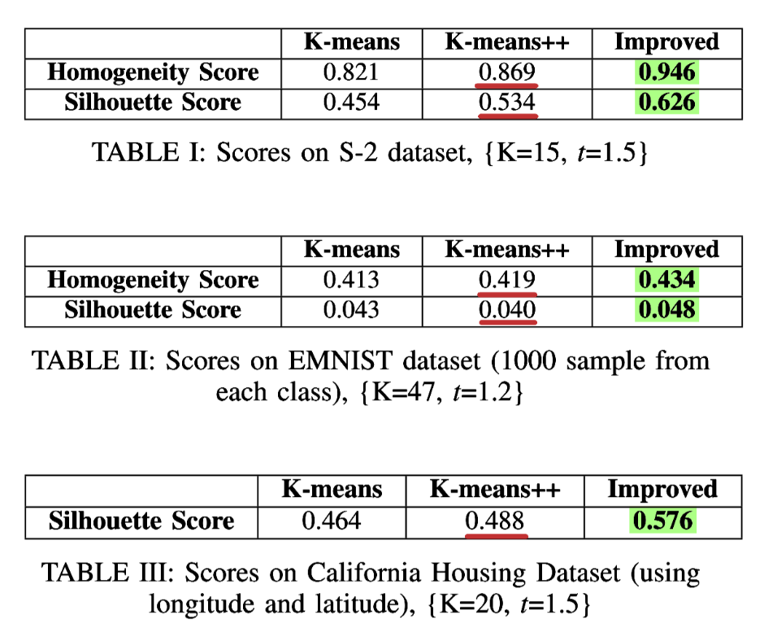
Results: Comparison of the Improved algorithm [8]
Homogeneity and silhouette score improve compared to K-Means(++)
Homogeneity score
Shows how well a cluster holds data of only one class
Silhouette score
Measures how similar a data point is to its cluster compared to other
Fig. 26: Improved scores through the algorithm [8].

Slide 47
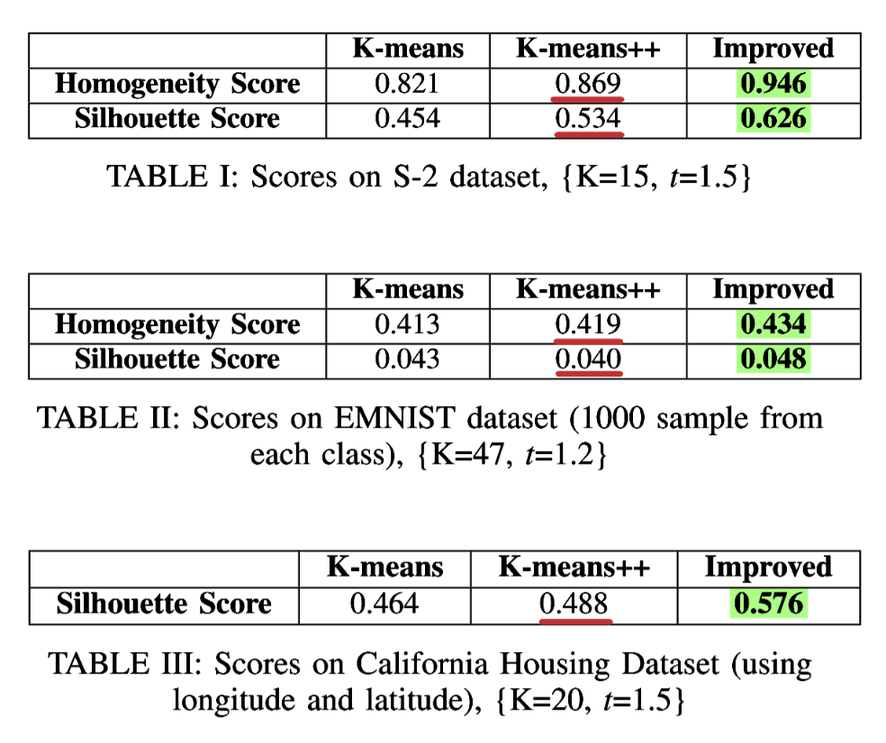
Results: Comparison of the Improved algorithm [8]
Tabelle I (S-2 Dataset)
H-Score: +8.86%
S-Score: +17.23%
Tabelle II (EMNIST Dataset)
H-Score: +3.58%
S-Score: +20.00%
Tabelle III (California Housing Dataset)
S-Score: +18.54%
Fig. 26: Improved scores through the algorithm [8].

Slide 48
Results: Computational costs [8]
Impact on costs
Extra operations
Selecting correct parameters
Compared to current solutions
Fewer but more efficient iterations
Good results can be found directly

Slide 49
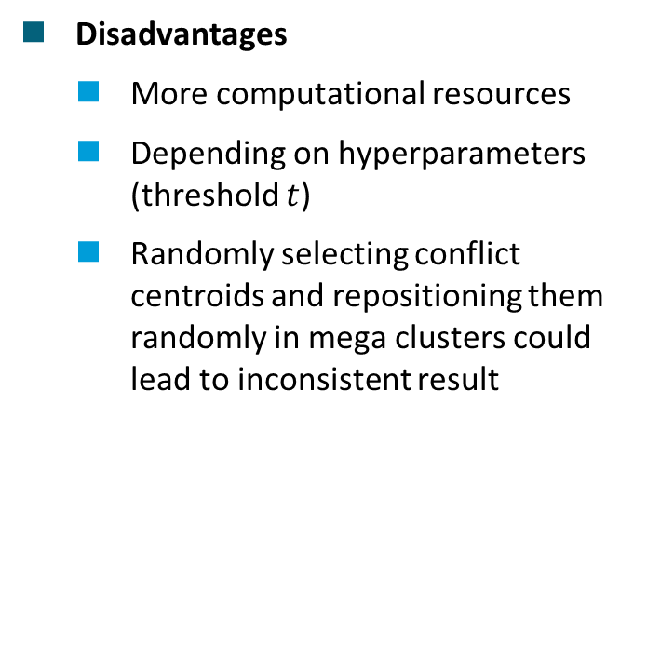
Results: Advantages and Disadvantages of the improvement
Advantages
Normally, K-Means is computed multiple times and poor results are discarded
Easy to implement
More efficient use of additional computational resources
Disadvantages
More computational resources
Depending on hyperparameters (threshold $t$)
Randomly selecting conflict centroids and repositioning them randomly in mega clusters could lead to inconsistent result

Slide 50


Demo: Improved Algorithm ‒ Mall Customer Segmentation
Contains data on customers of a shopping centre
Objective
Identify customer groups (clusters)
Benefit
Improved marketing strategies.
Personalised offers
Our measurements (20 iterations)
Fig. 27: Sample from the dataset [12,13].

Slide 51

Summary
K-Means is fast, simple, and easy to implement but sensitive to initial centroids
Key issues
Mega Clusters: Multiple groups merge into one
Conflicting Clusters: One group splits into several
Statistical methods address these problems and improving cluster quality (homogeneity and silhouette scores)
Further research is needed to fine-tune hyperparameters (threshold $t$)

Slide 52
Thank you for your attention.
Questions?

Slide 53
References
Lecture notes:
[1] W. Deuschle. (2019). Undergraduate Fundamentals of Machine Learning. Harvard College. URL: https://nrs.harvard.edu/URN-3:HUL.INSTREPOS:37364585
Book and Paper Sources:
[2] Y. Kushawah, A. Yadav. (2016). A Survey on Unsupervised Clustering Algorithm based on K-Means Clustering. International Journal of Computer Applications, 156(8), 6-9. DOI: 10.5120/ijca2016912481
[5] K. Joshi et al. (2015). Survey on Different Enhanced K-Means Clustering Algorithm. International Journal of Engineering Trends and Technology, 27(4), 178-182. DOI: 10.14445/22315381/IJETT-V27P233
[7] N. Sagala, A. Gunawan. (2022). Discovering the Optimal Number of Crime Cluster Using Elbow, Silhouette, Gap Statistics, and NbClust Method. ComTech: Computer, Mathematics and Engineering Applications, 13(1), 1–10. DOI: 10.21512/comtech.v13i1.7270
[8] A. Ihsanoglu, M. Zaval. (2024). Statistically Improving K-means Clustering Performance. 32nd Signal Processing and Communications Applications Conference (SIU), (Mersin, Turkiye), 1-4. DOI: 10.1109/SIU61531.2024.10601123.

Slide 54
References
Book and Paper Sources:
[9] J. Oyelade et al. (2019). Data Clustering: Algorithms and Its Applications. 19th International Conference on Computational Science and Its Applications (ICCSA), (St. Petersburg, Russia), 71-81. DOI: 10.1109/ICCSA.2019.000-1
[10] Iglesias, Martin. (2021). Dimensional and Discrete Emotion Recognition using Multi-task Learning from Acoustic and Linguistic features extracted from Speech. URL: https://www.researchgate.net/publication/353287610_Dimensional_and_Discrete_Emotion_Recognition_using_Multi-task_Learning_from_Acoustic_and_Linguistic_features_extracted_from_Speech
[18] Saha, A., Rajak, S., Saha, J. et al. (2024). A Survey of Machine Learning and Meta-heuristics Approaches for Sensor-based Human Activity Recognition Systems. J Ambient Intell Human Comput 15, 29–56. DOI: 10.1007/s12652-022-03870-5
Internet Sources:
[3] https://github.com/afshinea/stanford-cs-229-machine-learning/blob/master/en/cheatsheet-unsupervised-learning.pdf, LA 01/2025
[4] https://foodtribute.com/wp-content/uploads/2016/02/Different-types-of-bread.jpg, LA 01/2025
[11] https://scikit-learn.org/stable/auto_examples/cluster/plot_cluster_comparison.html, LA 01/2025

Slide 55
References
Internet Sources:
[12] https://github.com/Gracysapra/K-Means-Clustering/tree/main, LA 01/2025
[13] https://www.kaggle.com/datasets/vjchoudhary7/customer-segmentation-tutorial-in-python, LA 01/2025
[14] https://medium.com/@ankitem745/recommendation-system-netflix-collaborative-filtering-using-matrix-factorization-2860ccd560c0, LA 01/2025
[15] https://allthingsgraphed.com/2014/11/02/twitter-friends-network/, LA 01/225
[16] https://blog.aspiresys.com/data-and-analytics/customer-segmentation-empowered-by-machine-learning-reap-the-benefits-of-ai-to-serve-your-customers-better/, LA 01/2025
[17] https://www.startlemusic.com/blog/music-genres-explained, LA 01/2025
[19] https://towardsdatascience.com/k-means-clustering-algorithm-applications-evaluation-methods-and-drawbacks-aa03e644b48a, LA 01/2025
[20] https://www.g2.com/de/articles/big-data-statistics, LA 01/2025
[21] https://github.com/Gracysapra/K-Means-Clustering/tree/main, LA 01/2025
[22] https://www.kaggle.com/datasets/vjchoudhary7/customer-segmentation-tutorial-in-python/data, LA 01/2025

